Slide 1
Public or Private Equity?
The Evolving Entrepreneurial Finance Landscape
Michael Ewens (Caltech)
Joan Farre-Mensa (University of Illinois at Chicago)

Slide 2
Why should we care about private firms?
All entrepreneurial firms start being privately held
Those that are successful eventually face the decision of whether to go public or stay private
  This decision is not taken in a vacuum: Decisions that entrepreneurs take early in the life of their firms (well before an IPO is an option) impact their eventual ability to go public or stay private
  For instance, if an entrepreneur raises VC financing, the VCs gain control of her board of directors, and the startup goes on to be successful, she’ll have a hard time keeping it private and independent
As it turns out, many firms decide to stay private...

Slide 3
Importance of private firms
Most U.S. firms are not stock market listed
  Less than 0.1% of the 5.7 million firms in the U.S. are public (2010)
    The 5.7 million firms do not include self-employed individuals
This is true even for large firms
  Among firms with >500 employees, less than 15% are public
Private firms account for
  over 50% of aggregate non-residential fixed investment
  around 2/3 of private-sector employment
  over 55% of sales
Importance of private firms is even greater in other countries (e.g., Germany, Italy)

Slide 4
Most of these are not VC or PE owned, which number a few thousand (<20,000)!
Source: Farre-Mensa (2017); data from 2007

Slide 5
Agenda for today
  What is factually different btw public and private firms?
  What are the economic differences stemming from these factual differences?
  What are the differences in the behavior of public and private firms?
      Identification challenges
  Changes in the entrepreneurial finance landscape over the last two decades

Slide 6

Defining public, private, and semi-public firms
Public firm = Firm whose shares are listed in a major stock exchange (in the U.S., NYSE or Nasdaq) → Shares need to be registered (file Form S-1)
Gray area (“semi-public” firms). Two types:
  Firms w/ shares listed in “minor” exchanges (e.g., OTC, BB, pink sheets). Aka “Twilight Zone.” See https://www.otcmarkets.com
        Mix of “fallen angels” & “rising stars” (Brüggemann et al. (RFS 2018): ~10,000 firms 2001-2010)
  Firms that have to file financ. statements w/ SEC. Two potential reasons:
      Above filing thresholds ($10 M assets and >= 2,000 shareholders (500 pre JOBS Act))
      Have chosen to register their equity or debt securities (e.g., have public bonds)
        Either registered in current year, or in past year and still have >= 300 recordholders
        Gao, Harford, and Li JFE 2013: ~3,600 firms 1995-2011
(Pure) private firm = All other firms

Slide 7
What is factually different btw public and private firms?
What changes when a firm registers and lists its shares?
  Share liquidity increases, restrictions on number/type shareholders lifted, solicitation restrictions lifted
    Stock exchanges provide centralized venue where investors can easily trade shares, efficiently (and anonymously) matching buying and sellers
    When private firms issue securities, they must meet one of the exemptions from registration of Section 4(a)(2) of the Securities Act. Public firms do not need to worry about meeting these exemptions
      Most common exemption is Rule 506 of Regulation D (506(b) & 506(c))
        Limit the sale of securities to accredited investors (and ≤ 35 non-accredited in the case of 506(b)), but no limit on no. of accredited investors or offer size
        Rule 506(b) also prohibits general solicitation (advertising) of the offering
      Other exemptions are Rule 504, Reg A and Reg crowdfunding (all limit offer size)
      Securities sold under Rule 506 are restricted securities that cannot be immediately or easily traded. Need exception (e.g., Rule 144, Section 4(a)(1½), Section 4(a)(7). Often requires issuer cooperation

Slide 8
What is factually different btw public and private firms?
What changes when a firm registers and lists its shares?
  Information environment
    Firm must publicly file w/ the SEC:
      Initial registration statement (Form S-1)
      Regular financial statements (10-K, 10-Q)
      Current reports (8-K) disclosing certain material events w/in 4 days
        Shareholders that cross 5% must file beneficial ownership report
        “Insiders” (officers, directors, 10% shareholders) must report stock transactions w/in 2 days
    Firm subject to insider trading laws and not allowed to selectively disclose material information to investors (that are not insiders)
      SEC wants to ensure a level playing field – in particular, access to same info – among investors
        Regulation Fair Disclosure (2000) formalizes/clarifies much of this
        Under Section 16, insiders must return any short-term (<6 months) trading profits

Slide 9
What is factually different btw public and private firms?
What changes when a firm registers and lists its shares?
  Regulatory environment
    Firm must comply w/ financial and corporate governance listing requirements of the exchange (see: Nasdaq, NYSE)
      E.g., in the least stringent Nasdaq tier, a firm must have (among other requirements):
        (market value of publicly held shares >= $15 million) or (market value of publicly held shares >= $5 million & net income from cont. ops. >= $0.75 million)
        a majority of independent directors in its board
    Firm must comply w/ federal regulations that apply only to public firms
      SEC disclosure regulations (discussed before)
      Additional auditing and internal reporting controls (Sarbanes-Oxley Act of 2002)
    Firm must comply w/ state regulations that apply only to public firms
        E.g., 2020 California board diversity requirement (SB 826 and AB 979)
    Firm exempt from most state blue-sky laws governing security issues
      Since NSMIA (1996), private firms issuing securities under Rule 506 also exempt

Slide 10
From factual to economic differences
Previous 3 slides describe “objective facts” (mostly, regulations) that change when a firm goes public
  Semi-public firms fall somewhere in between pure private and public:
    Private firms listed OTC (particularly in highest tier market, OTC-QX) may have similar liquidity to some (small) Nasdaq firms
        Most of these firms are also SEC filers w/ registered (→ freely tradeable) shares
    Private firms that are SEC filers operate in info. environment that is closer to that of public firms than to that of pure private firms (e.g., they are covered by Reg FD)
Next step: What are the economic differences btw/ public and private firms that follow from the above factual differences?
  Need theory and/or empirics, open for discussion and research
  Focus on pure private firms (non-OTC & non-SEC-filers)

Slide 11
Agenda for today
  What is factually different btw public and private firms?
  What are the economic differences stemming from these factual differences?
  What are the differences in the behavior of public and private firms?
      Identification challenges
  Changes in the entrepreneurial finance landscape over the last two decades

Slide 12
Better access to and lower cost of capital for public firms – equity
Higher liquidity of shares of public firms (easier/faster to buy/sell, no resale restrictions) → investors willing to pay more for them
No limit on no. of shareholders → easier to raise capital, easier to have well-diversified shareholder base that does not need to be compensated for bearing idiosyncratic risk
    VC/PE funds can replicate some/much of this diversification benefit
Access to larger pool of investors (e.g., no accreditation requirement, no general solicitation restrictions) → easier to raise capital, higher stock price if demand curves for stocks slope down (not a settled question)

Slide 13
Better access to and lower cost of capital for public firms – equity
How much do these advantages increase valuation of public firms, all else equal?
    Officer (JFE 2007): analysis of acquisition equity multiples shows private targets sell at a discount of 15% to 30% on average relative to industry- and size-matched public targets
Higher liquidity of public firms’ shares valuable to founders, employees (e.g., if they have stock options), and initial investors (e.g., VCs) if they want to exit their investment
      Founders/employees of private firms may be “paper millionaires” that are cash poor (Bodnaruk et al. (RFS 2008): undiversified founders more likely to go public)
      It may be easier for public firms to attract and retain employees, but it may also be easier to lose them if they can more easily cash out
Higher liquidity – and better price discovery – facilitates use of shares as currency to pay for acquisitions (Celikyurt, Sevilir & Shivdasani JFE 2010)

Slide 14
Lower cost of capital for public firms – debt
Saunders & Steffen (RFS 2011) show that UK private firms pay loan spreads btw/ 26 and 60 basis points higher than public ones
Why?
  Richer information environment surrounding public firms means that banks face lower cost of info. production when lending to public firms
      Difference btw/ public and private firms disappears when examining private firms that have issued public bonds, whose info. environment similar to that of public firms
  Public firms have greater bargaining power when negotiating w/ lenders
      Lower cost of equity helps them negotiate w/ banks (e.g., Rajan JF 1992)
  Higher ownership concentration in private firms → less agency pbms. btw/ managers and shareholders → enhanced risk-taking incentives (not so much “enjoying the quiet life” – quiet life is good for lenders!)
      Firms w/ more concentrated ownership pay higher spreads

Slide 15
Public firms face two-audiences problem when communicating w/ investors
Suppose a firm figures out that search engines can be very profitable. If firm is public, it faces two-audiences pbm (Bhattacharya & Ritter REStud 1983):
  It can make the info public. This will increase the firm’s valuation and decrease its cost of capital, but it will also alert current and potential new competitors of the profitability of the search engine business
  It can keep the info private, which will likely mean that the firm will be undervalued (for some time)
    This undervaluation can erode the cost-of-capital advantage of being public
    It can also damage employee moral (particularly if they are shareholders!)
    To be sure, if the firm is very large, it can be hard to keep the info private due to both regulatory and practical reasons
Private firms do not face this two-audiences problem. They can communicate w/ selected investors (current and potential) w/o making the info public and thus available to competitors

Slide 16
Public firms face two-audiences problem when communicating w/ investors – The Google case
From Google’s Form S-1 (2004):
“As a smaller private company, Google kept business information closely held, and we believe this helped us against competitors. … As a public company, we will of course provide you with all information required by law…. But we will not unnecessarily disclose all of our strengths, strategies and intentions.”
Complex relationship between a firm’s listing status and the information available to investors:
  There is far more publicly available information about the average public than the average private firm
  But, private firms’ shareholders often gain access to proprietary information that is off-limits to investors in public firms

Slide 17
Dispersed ownership & separation of ownership and control can give raise to agency problems in public firms
Dispersed ownership & separation of ownership and control → Management may choose to maximize its own objective function instead of doing what is best for the firm and its shareholders
  In public firms, most shareholders own too small a stake in the firm to pay the fixed cost of monitoring management
  Long literature in econ and finance analyzes these agency problems as well as the mechanisms that can alleviate them
Agency pbms can also exist in private firms: both btw/ mgmt. and shareholders, and btw/ majority and minority shareholders
However, ownership concentration and little (if any) separation btw/ ownership and control limits scope of potential agency pbms.
Even when ownership and control are separated, there is usually little info. asymmetry in private firms btw/ mgmt. and shareholders

Slide 18
Public firms and short-termism
Public firms may be subject to stronger short-termist pressures than private ones. Three fundamental differences may play role:
  Two-audiences pbm. can accentuate info. asymmetry btw/ firm and public firm stock mkt investors – and analysts
      Short-termism models need info. asymmetry (see, e.g., Stein QJE 1989). Otherwise, any profitable long-term investment should be reflected in today’s stock price
      Private firms are opaque to general public but not to their investors, which are usually in close contact w/ mgmt. and so can understand value of long-term investments
  Public firms have little control over their shareholder base, so they may end up w/ short-term oriented investors. Private firms tend to carefully select their investors to ensure goals are aligned
      E.g., Agarwal, Vashishtha & Venkatachalam (RFS 2018)
  Quarterly earnings disclosure cycle can accentuate pressure to meet short-term forecasts, potentially at expense of long-term investments
      E.g., Graham, Harvey, and Rajgopal (JAE 2005); Almeida, Fos & Kronlund (JFE 2016)

Slide 19
Public firms and short-termism – The Google case
From Google’s Form S-1 (2004):
As a private company, we have concentrated on the long term, and this has served us well. As a public company, we will do the same. In our opinion, outside pressures too often tempt companies to sacrifice long-term opportunities to meet quarterly market expectations.
If opportunities arise that might cause us to sacrifice short term results but are in the best long term interest of our shareholders, we will take those opportunities. … We would request that our shareholders take the long term view.
But just in case they did not, they set up a dual class structure:
In the transition to public ownership, we have set up a corporate structure that will make it harder for outside parties to take over or influence Google. This [dual class] structure will also make it easier for our management team to follow the long term, innovative approach emphasized earlier.

Slide 20
Economic differences btw public and private firms – Summary
Public firm advantages
  Lower cost of equity and debt, better access to capital
  Easier exits for founders & investors
  Easier to use shares as currency for acquisitions
  Can rely on info. embedded in stock price to make investment decisions
  Higher reputation & visibility w/ customers and potential partners
Public firm risks and costs
  Two-audiences problem
  Agency problems
  Short-termist pressures
  Litigation risk
    Frivolous securities class action lawsuits (Kempf & Spalt 2020); patent lawsuits (Caskurlu 2020)
  Higher expenses (IPO + ongoing (auditing, investor relationships, etc))

Slide 21
Agenda for today
  What is factually different btw public and private firms?
  What are the economic differences stemming from these factual differences?
  What are the differences in the behavior of public and private firms?
      Identification challenges
  Changes in the entrepreneurial finance landscape over the last two decades

Slide 22
  Differences in the behavior of public and private firms
  Investment (including M&A)
  Innovation
  Capital structure
  Cash
  Payout

Slide 23
Comparing investment of publics and private firms
Literature has focused mostly on comparing sensitivity of investment to investment opportunities of public and private firms
  No Tobin’s Q (= mkt-to-book) for private firms, so inv opps usually measured using sales growth or an ad-hoc, industry-specific measure
Two main competing hypothesis:
  Public firms’ better access to and lower cost of capital (in other words, lower financial constraints) allows them to invest more efficiently and be more responsive to inv opps
  Short-termist pressures distort investment decisions of public firms, leading them to be less responsive to inv opps
Of course, both can be true. Which effect dominates is likely to vary across industries (and maybe also time periods)

Slide 24
Comparing investment of publics and private firms
Unsurprisingly, lit has found divergent investment sensitivity results
  Higher investment sensitivity to inv opps for public firms, likely due to financial constraints
    Mortal & Reisel (JFQA 2013)
      European sample (better data on private firms!), differential only exists in countries w/ well-developed stock markets, pointing to financing channel
    Gilje & Taillard (JF 2016)
      Natural gas firms in the US. They find that private firms adjust drilling activity for low capital-intensity investments, but they do not increase drilling in response to new capital-intensive growth opps; instead, they sell these projects to public firms
    Phillips & Sertsios (RFS 2017)
      They find that publicly traded companies increase their external financing and their subsequent product introductions by more than private companies in response to Medicare national coverage approvals
    Other (wp): Dougal & Rettl (2020), Maksimovic, Phillips & Yang (2020)

Slide 25
Comparing investment of publics and private firms
Unsurprisingly, lit has found divergent investment sensitivity results
  Higher investment sensitivity to inv opps for private firms, likely due to agency pbms / short-termism
    Asker, Farre-Mensa & Ljungqvist (RFS 2015)
      Large, multi-industry sample of US firms. Difference in sensitivity to inv opps driven by firms in industries in which stock prices are most sensitive to earnings news, where short-termist pressures are strongest (Stein QJE 1989)
    Sheen (JFQA 2020)
      Compares inv of public and private chemical. Private firms more likely to increase capacity prior to positive demand shock and less likely before negative shock. Mechanisms: public firm overextrapolation of past demand shocks & agency pbms
Public and private firms also differ in their M&A practices
    Maksimovic, Phillips, and Yang (JF 2013)
      Public firms participate more as buyers and sellers of assets in merger waves and their participation is affected more by credit spreads and aggregate market valuation

Slide 26
Comparing innovation of publics and private firms
Acharya & Xu (JFE 2017):
  Public listing facilitates the innovation of firms in industries that are more dependent on external finance because the access to public equity helps alleviate financial constraints
  However, public listing could impede the innovation of firms with less need for external capital due to the exposure to short-termism
  Dep. var.: Patents & R&D
    Sample of private firms from Cap IQ, so these are SEC-filing semi-public firms. Same is true for Gao, Hsu & Li (JFQA 2018) below
Aggarwal & Hsu (MS 2014), Bernstein (JF 2015):
  Higher innovation quality for private firms
Gao, Hsu & Li (JFQA 2018):
  Public firms’ patents rely more on existing knowledge, are more exploitative, and are less likely to be in new technology classes, while private firms’ patents are broader in scope and more exploratory
  Shorter investment horizon associated with public equity markets is key explanatory factor

Slide 27
Identification
Key challenge: Are investment, innovation, or any other diffs btw/ public and private firms caused by their listing status, or are there inherent unobservable diffs btw those firms that choose to go public and those that stay private that also drive the diffs in the studied outcomes?
    E.g.: Firms w/ high inv opps may decide to go public to raise cheaper capital. Such firms invest more than those that stay private. But much (or all) of the diff may be due to the higher inv opps, not to listing status
How to address this challenge? Several approaches:
  Matching
    Done (in some form) by ~ all papers that compare public and private firms
        Otherwise, large observable diffs btw public and private firms (e.g., size, industry)
    Challenge: can only match on observables, so unobservable diffs remain
        For matching to produce causal estimates, need Conditional Independence Assumption → All variables that influence listing status and potential outcomes are observed by researcher. Unlikely!

Slide 28
Identification
How to address this challenge? Several approaches:
  Matching
  Comparing firms before/after IPO (or delisting)
    Advantage: Can differentiate away time invariant unobservable differences
    Challenge: IPO (or delisting) may be motivated by some unobservable change that may also affect outcome of interest (e.g., new inv opp)
        Acharya & Xu (JFE 2017): RD using listing standard as forcing variable
        Asker, Farre-Mensa & Ljungqvist (RFS 2015): Focus on secondary IPOs, less likely to be motivated by changes in investment opportunities
  Instrumental variables
    No “silver-bullet” IV for going-public decision
      This is such a fundamental decision, that it is not easy to find 100% convincing exogenous variation
      Still, one can try

Slide 29
Identification
How to address this challenge? Several approaches:
  Matching
  Comparing firms before/after IPO (or delisting)
  Instrumental variables
    Instrumenting the going public decision
      Geography-based IVs have been popular
        UK: Distance from London (Saunders & Steffen (RFS 2011))
        US: state-level household stock mkt participation in 1984 (Gao et al. (JFQA 2018))
        US: VC supply in a firm’s headquarter state two years after founding (idea: raising VC increases IPO prob; Asker et al. (RFS 2015))
      Others have exploited industry-level variation (e.g., Gao et al. (JFE 2013) exploit industry-level diffs in underwriter concentration)
      Important to discuss who are the compliers whose LATE the IV identifies? This matters if one expects meaningful heterogeneity in the effects of being public

Slide 30
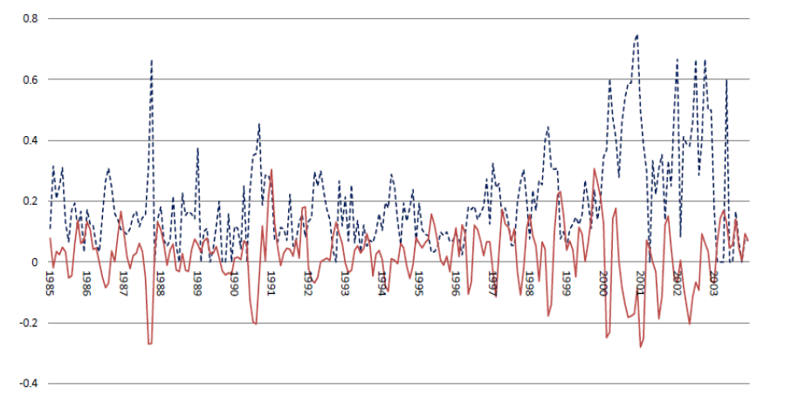
Bernstein (2015): Better but narrower identification
In light of challenges w/ finding exogenous variation in the decision to go public, Bernstein (JF 2015) holds the decision constant, exploiting exogenous variation on whether – conditional on deciding and trying to go public – a firm is able to successfully complete its IPO
  Instrument for IPO completion: NASDAQ fluctuations during the book-building phase → provides a plausibly exogenous source of variation that affects IPO completion but unlikely to affect long-run innovation opportunities
Blue line: Fraction of monthly IPO filings that eventually withdrew
Red line: Two month NASDAQ return

Slide 31
Bernstein (2015): Findings
Public ownership changes firms' innovation strategies:
Going public affects the nature of internal innovation
  No evidence for a change in innovation scale (number of patents)
  Public firms generate lower quality innovation (citations per patent)
Going public affects inventors
  Key inventors are more likely to leave
  Effect is eased by hiring of new inventors
1) and 2) mitigated when CEO is also chairman of the board, consistent w/ agency pbms distorting innovation decisions of public firms
  Career concerns (or short-termist pressures) may lead managers to select more incremental and less risky projects
Clean identification comes at expense of potentially limited external validity: Do findings apply to private firms that do not decide to go public?

Slide 32
More differences btw public and private firms
Private firms tend to…
  Have higher leverage (Brav JF 2009)
  Have less cash (Gao, Harford & Li (JFE 2013), Farre-Mensa (2017))
    Surprising: Within public firms, smaller and riskier firms tend to have more cash
    Gao et al.: Higher agency pbms in public firms lead them to hoard cash
        Semi-public firms from Capital IQ (SEC filers)
    Farre-Mensa: public firms hold more cash for precautionary reasons to ensure they do not need to raise capital every time new inv opp arrives, since two-audiences pbm means that they could be undervalued
        Private firms from Sageworks (non-SEC filers, so not subject to two-audiences pbm)
  Pay less smooth dividends (Michaely & Roberts (RFS 2012))
    Suggests that scrutiny of public capital markets induces dividend smoothing
  Have CEOs w/ lower turnover rates and exhibit lower turnover-performance sensitivity (Gao, Harford & Li (JFQA 2017))
    When controlling for pre-turnover performance, performance improvements after turnover greater for private firms than for public firms. Short-termism appears to be contributing factor

Slide 33
Agenda for today
  What is factually different btw public and private firms?
  What are the economic differences stemming from these factual differences?
  What are the differences in the behavior of public and private firms?
      Identification challenges
  Changes in the entrepreneurial finance landscape over the last two decades

Slide 34
Startup exits
There is no regulatory or other reason why startups need to exit – i.e., go public or be acquired
  A firm can stay private and independent “forever” (e.g., Cargill, founded in 1865). In doing so, the firm will face the costs & benefits discussed above
However, if a startup has raised venture capital, VCs will typically push for an exit sooner rather than later
    Typical VC funds are designed to last for 10 years on average − after 10 years, they must liquidate the investments and return $ to investors
      VCs very rarely collect dividends from their portfolio companies, so exits are usually the main liquidity event
    Investors in VC funds expect to receive cash (or shares of public companies) – they typically do not want to receive shares of private firms.
  Two prominent exit options for VCs and other investors:
    IPO
    Sale of the portfolio firm to another company (strategic acquisition) or to a financial acquirer (e.g., to a PE firm)

Slide 35
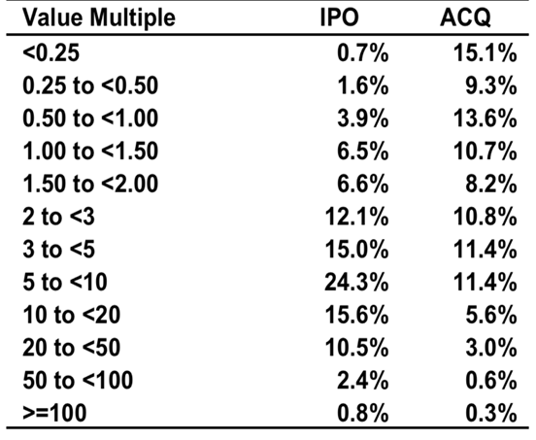
Value multiples for first-round investments: IPOs vs acquisitions
Value Multiple: Exit Value / Invested Capital
The value multiple tends to be higher in IPOs than in acquisitions
Thus, VCs tend to view IPOs as the best exit option
Note that some of these acquisitions might in essence be liquidations…
Source: Metrick and Yasuda (Wiley, 2010)

Slide 36
The decline in U.S. IPOs
Since the 1996, sharp decline in the number of IPOs in the U.S.
Average 1980-2000: 310 IPOs/year
Average 2001-2020: 113 IPOs/year
Source: Ritter IPO Statistics for 2020 and Earlier Years, Table 1

Slide 37
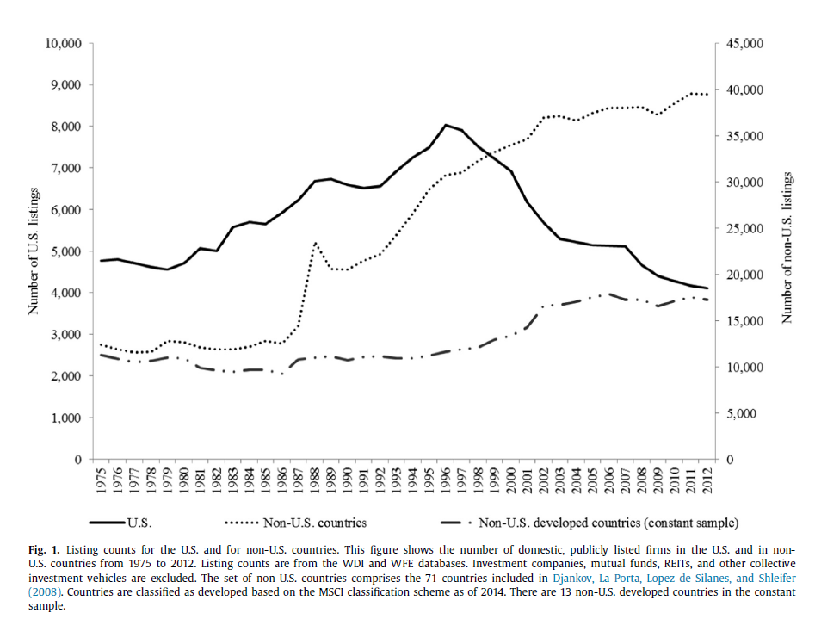
… and the U.S. listing gap
Doidge, Karolyi & Stulz (JFE 2017):
  Since listing peak in 1996, propensity to be listed is lower for all firm size categories and industries, the new list rate is low, and the delist rate is high

Slide 38
… and the U.S. listing gap
Doidge, Karolyi & Stulz (JFE 2017):
  Since listing peak in 1996, propensity to be listed is lower for all firm size categories and industries, the new list rate is low, and the delist rate is high
  The high delist rate accounts for 46% of the listing gap and the low new list rate for 54%
  The high delist rate is explained by an unusually high rate of acquisitions of publicly listed firms

Slide 39
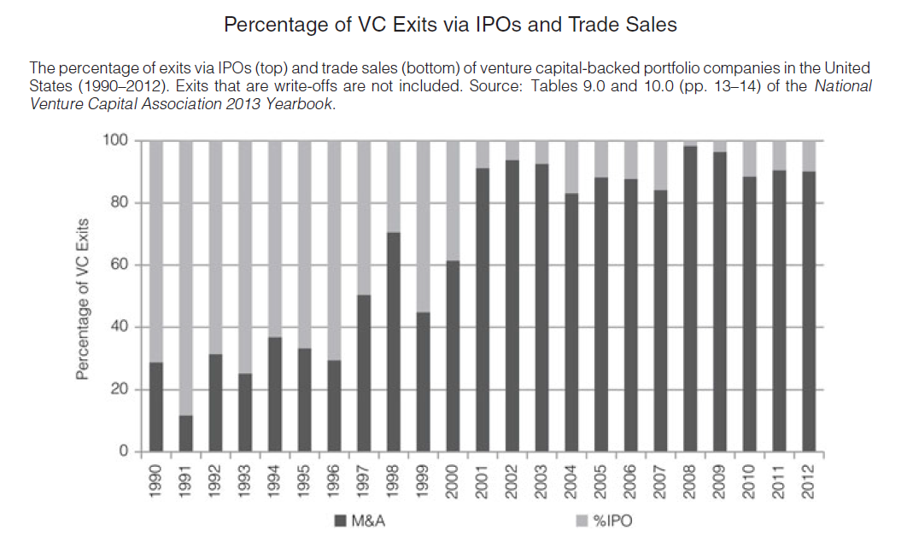
Why have IPOs declined?
Since 1996, sharp decline in the number of IPOs in the U.S.
Why?
  Gao, Ritter & Zhu (JFQA 2013): Advantages of selling out to a larger organization, which can speed a product to market and realize economies of scope, have increased relative to the benefits of operating as an independent firm

Slide 40
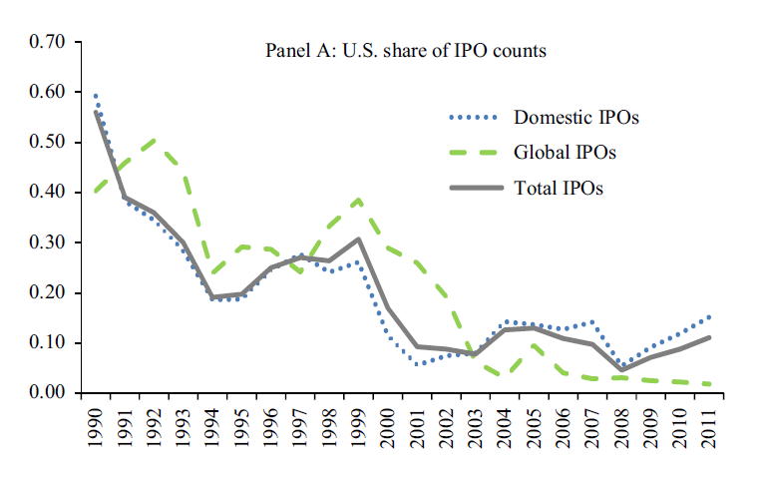
Why have IPOs declined?
Since 1996, sharp decline in the number of IPOs in the U.S.
Why?
  Gao, Ritter & Zhu (JFQA 2013): Greater economies of scope → more M&A exits
  Doidge, Karolyi & Stulz (JFE 2013): Agree w/ Gao et al. that regulatory changes in the US (e.g., SOX in 2002) unlikely to explain this decline. Point to the fact that IPO decline is mostly a U.S. phenomenon

Slide 41
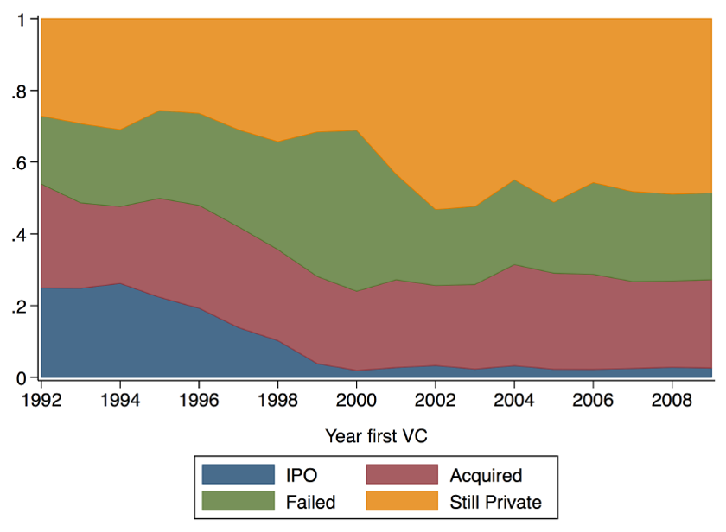
Exits – IPOs or M&As – are taking longer
Ewens and Farre-Mensa (RFS 2020) show that it is not simply that the VC-backed firms that used to exit via IPOs are now exiting via acquisitions
Rather, VC-backed firms appear to be taking longer to exit – i.e., many “mature” VC-backed firms are staying private instead of going public or being acquired
Exit status seven years after first VC

Slide 42
Firms are taking longer to exit
When VC-backed startups do go public, they are older
Source: Ewens and Farre-Mensa (RFS 2020)

Slide 43
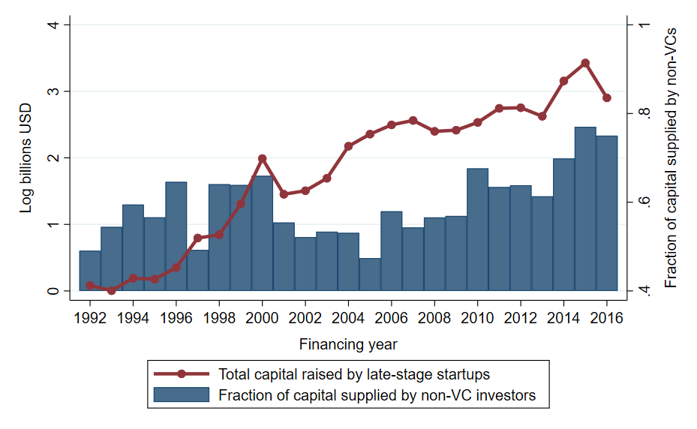
One reason: Firms are able to raise large amounts of capital while remaining private…
Source: Ewens and Farre-Mensa (RFS 2020)

Slide 44
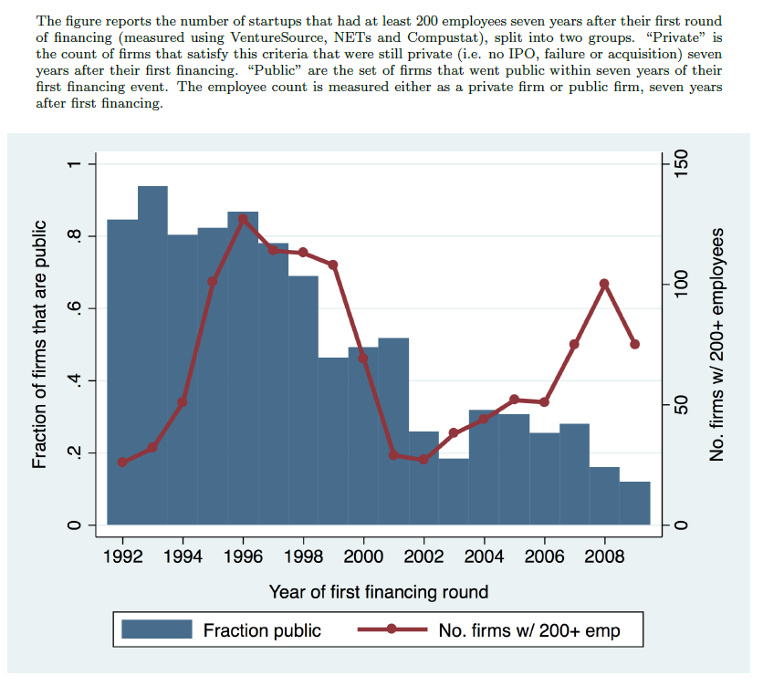
And so they can grow very big without an IPO
Source: Ewens and Farre-Mensa (RFS 2020)

Slide 45
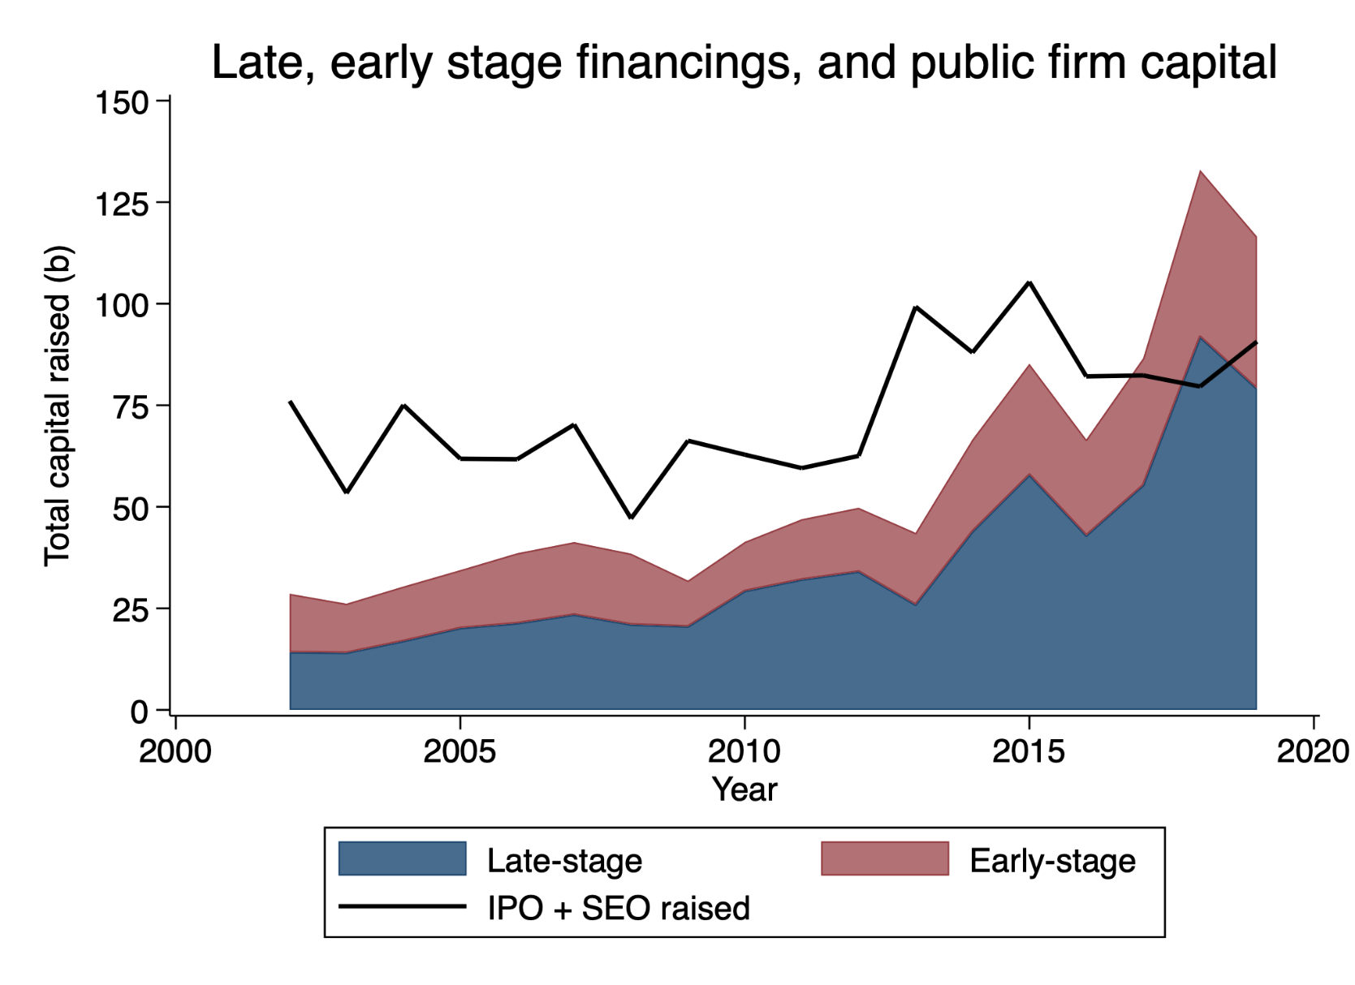
Public vs private markets
Source: Ewens and Farre-Mensa (2021)

Slide 46
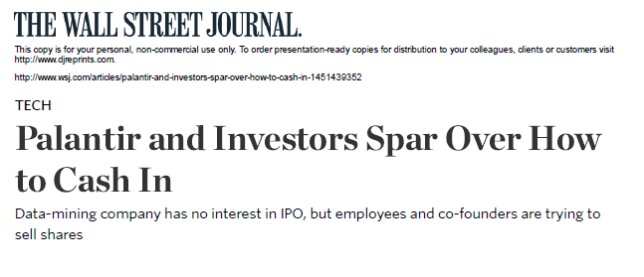
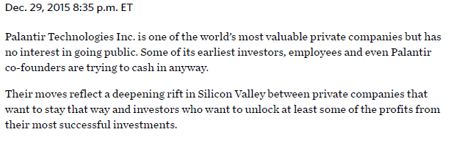
Not everyone is happy that exits are taking longer…
Of course, this is potentially problematic for VCs, because it means that they are having a hard time liquidating their investments and returning their capital to LPs.

Slide 47
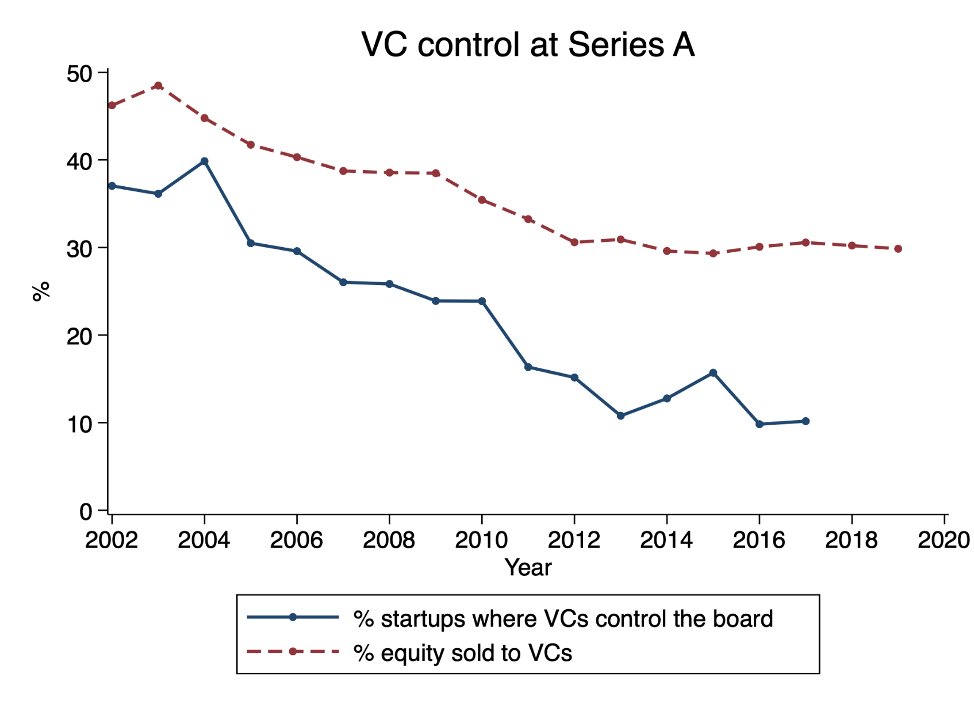
But founders have increasing bargaining power to make exit decisions, which allows them to delay exits – even if VCs are not happy about it
Source: Ewens and Farre-Mensa (2021)

Slide 48
What is behind these changes?
Demand-side changes
  Technological innovations appear to have decreased startups’ capital needs, particularly during the initial, experimental stage of the entrepreneurial process—when capital is most expensive
    E.g., cloud computing’s emergence in 2006 makes it possible for new startups to build software products without significant upfront investments, allowing them to raise smaller initial financing rounds (Ewens, Nanda, Rhodes-Kropf JFE 2018)
    Innovations such as CRISPR, a low-cost gene editing technology (Plumer et al. 2018), could have a similar impact in the biotechnology industry

Slide 49
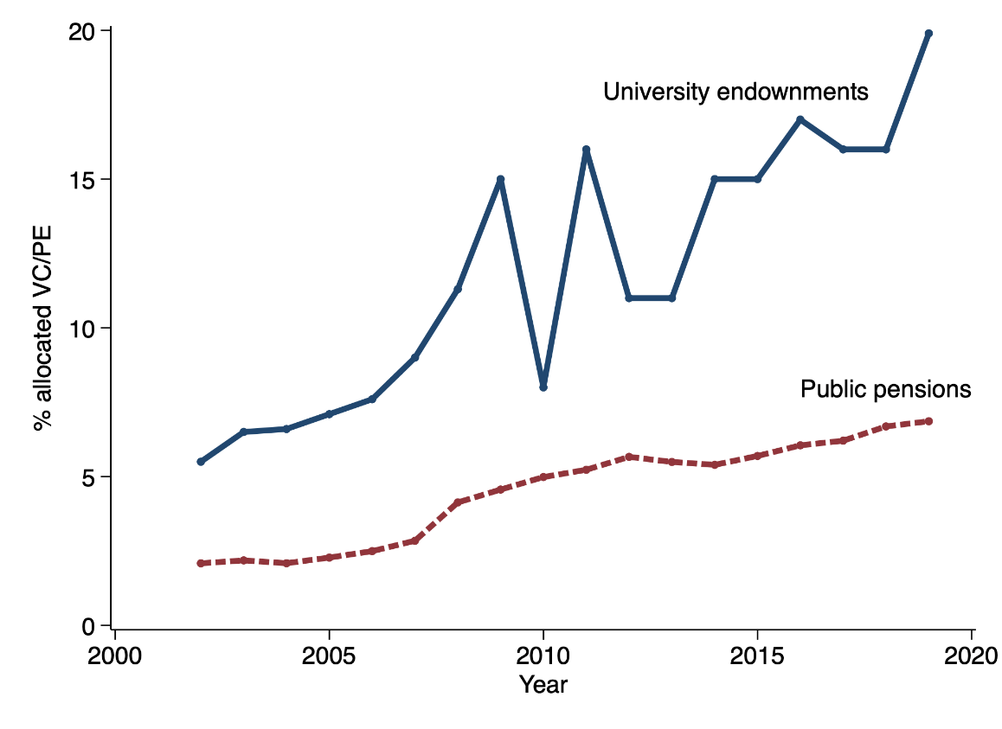
What is behind these changes?
Supply-side changes (I)
  More capital allocated to VC and PE funds by some of their major LPs, s.a. higher-ed endowments and public pension funds
  Why? Higher expected returns help decrease public pension fund gap
Source: Ewens and Farre-Mensa (2021)

Slide 50
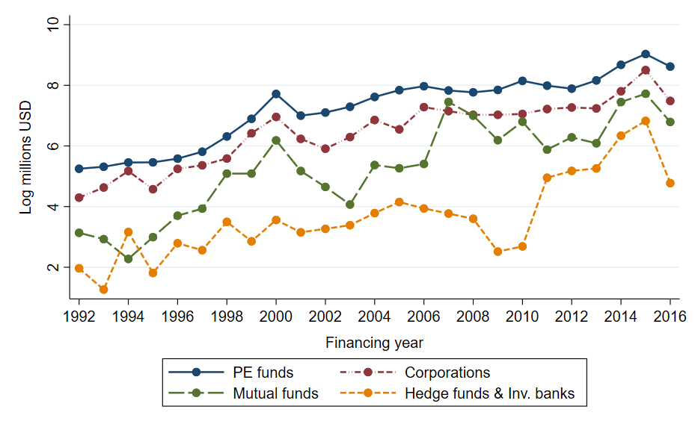
What is behind these changes?
Supply-side changes (II)
  New, non-traditional investors have entered entrepreneurial finance market, particularly late-stage
  Why? For traditional public investors s.a. mutual funds and hedge funds, investing in private firms can help them beat passively managed index funds and ETFs—and so justify their higher fees
Source: Ewens and Farre-Mensa (2020)

Slide 51
New equilibrium in entrepreneurial finance market
Number of listed firms has fallen sharply
Capital has flowed to the private markets, particularly in late-stage rounds, both via traditional startup investors such as VC funds and via non-traditional investors such as PE, mutual, and hedge funds
New equilibrium in the entrepreneurial finance market features seemingly higher valuations for private firms and more founder-friendly contracts

