Slide 1
Private or Public Equity?
The Evolving Entrepreneurial Finance Landscape
Michael Ewens (Caltech and NBER)
Joan Farre-Mensa (University of Illinois at Chicago)
April 2022

Slide 2
Four motivating facts

Slide 3
Fewer IPOs and publicly-listed firms
Since the 1996, sharp decline in the number of IPOs in the U.S.
Average 1980-2000: 310 IPOs/year
Average 2001-2020: 113 IPOs/year
Source: Ritter IPO Statistics for 2020 and Earlier Years, Table 1

Slide 4
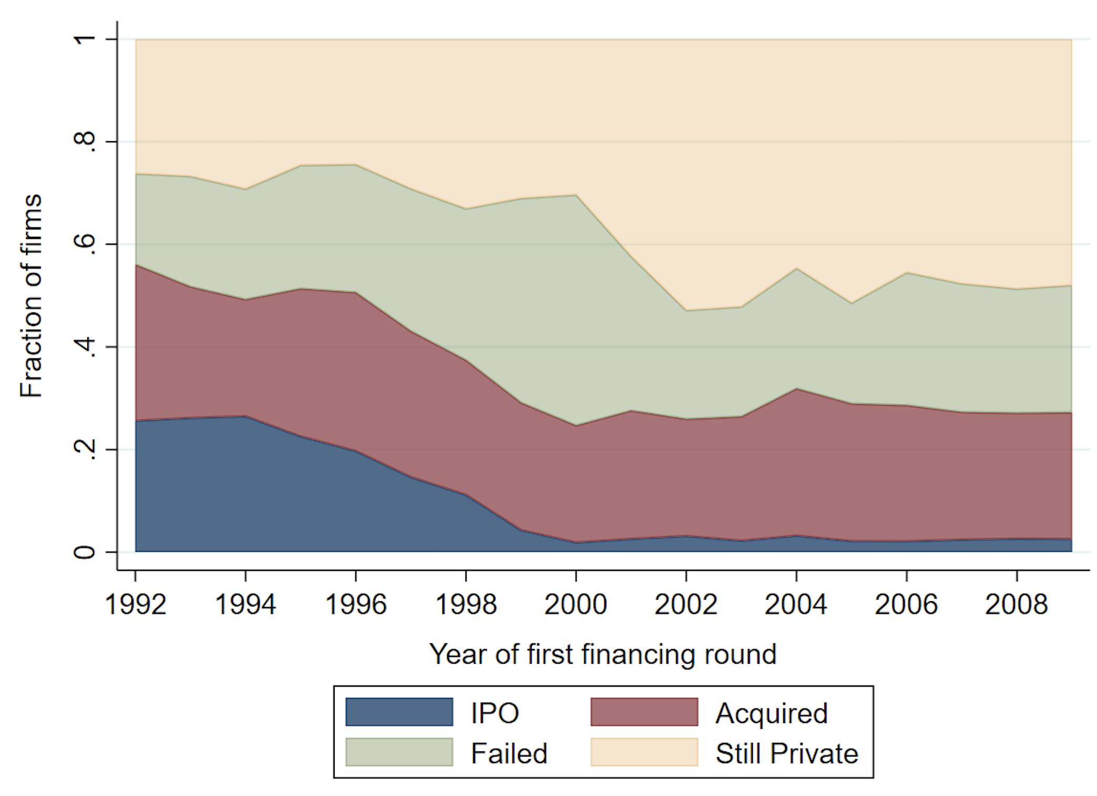
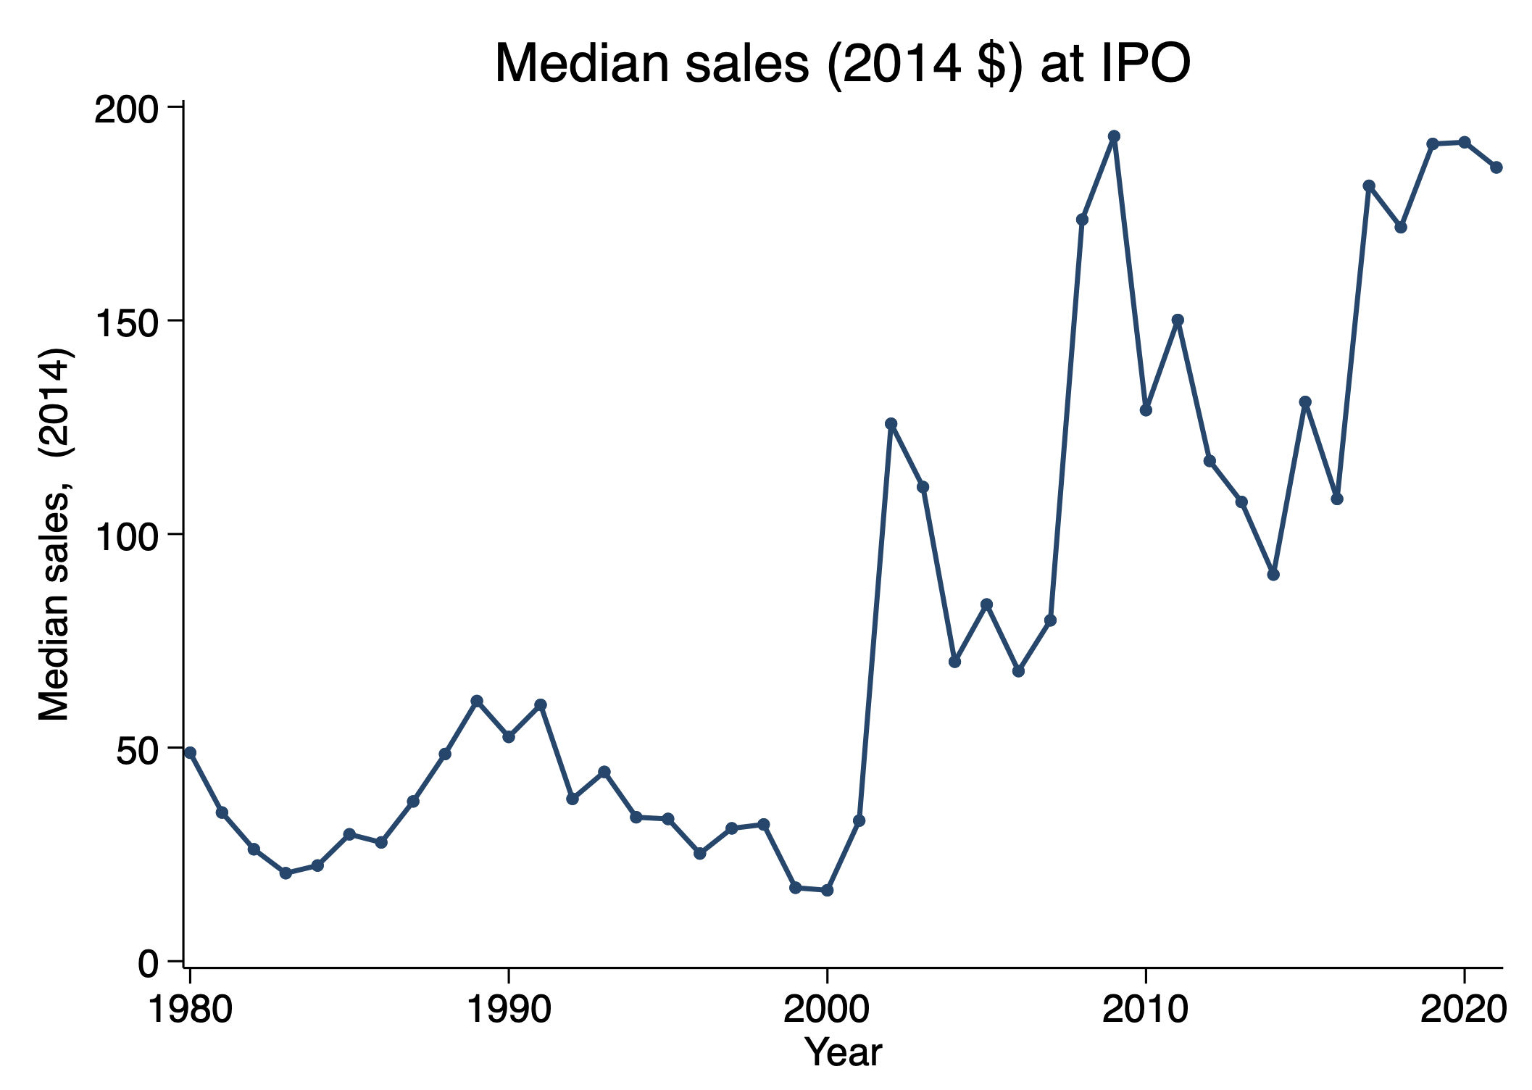
Private longer and larger at IPO
VC-backed exits in 7 years
Ritter (2022)
Ewens and Farre-Mensa (2020)

Slide 5
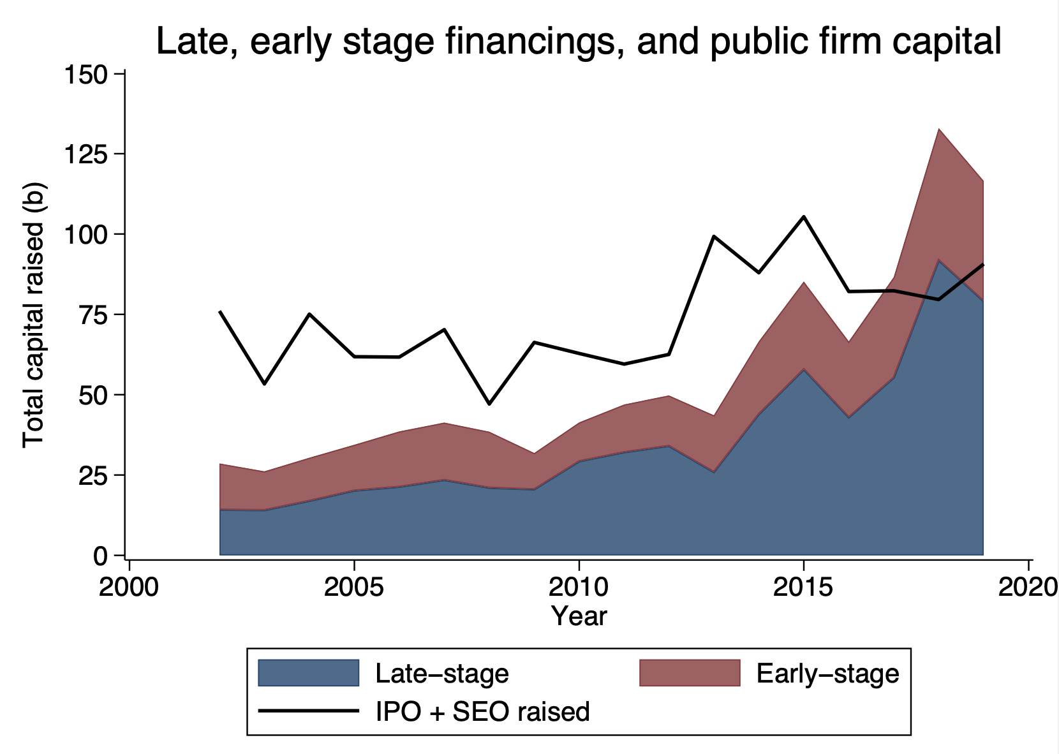
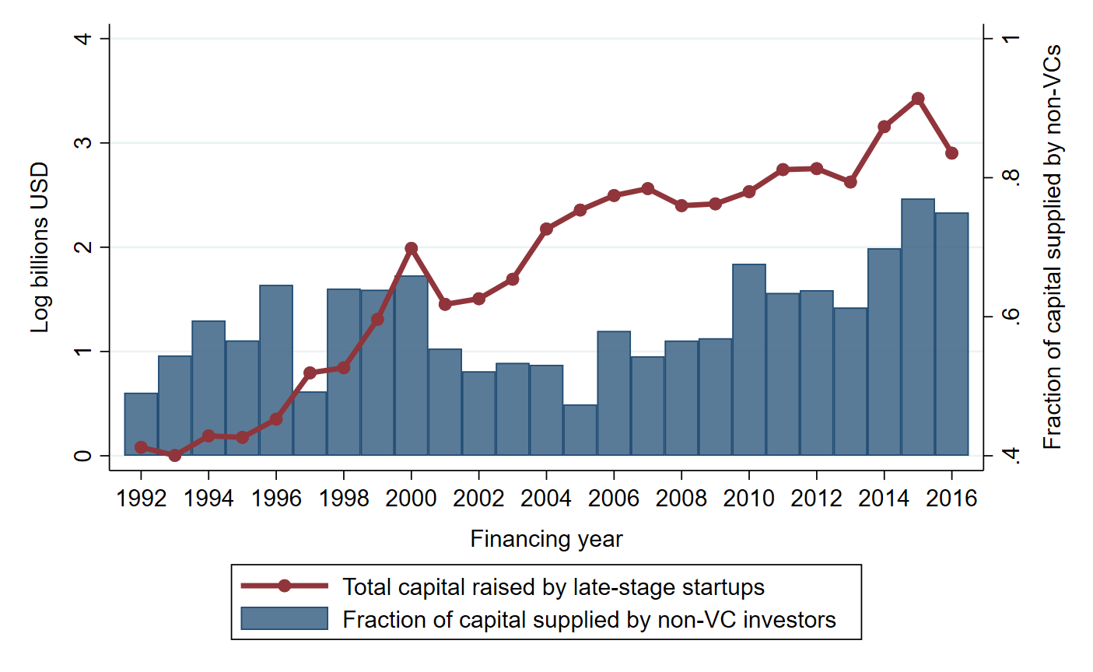
Late-stage startup financings: more capital from new (and old) investors
Growth in private capital driven by late-stage financings
Late-stage financings include more non-traditional investors

Slide 6
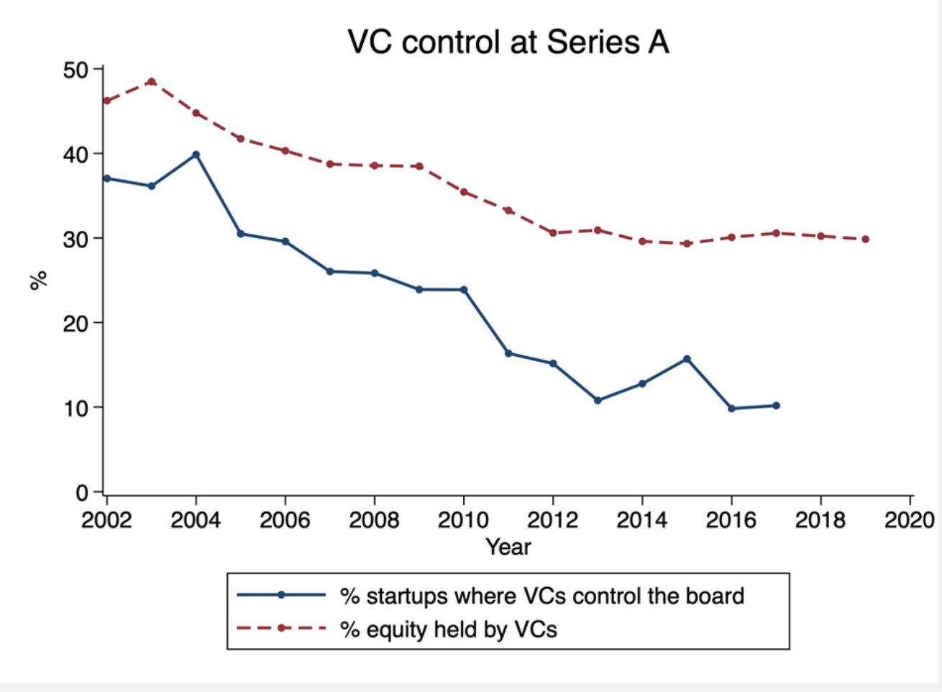
Early-stage financing: “cheaper” capital
Startup founders sell less equity in the early stages
Startup founders more likely to control their boards

Slide 7
Interconnection btw public & private markets
Significant changes in public and private capital markets over last 25+ years
Changes are interconnected
  E.g., private capital regulations affect public-private trade-off
Entrepreneurs and investors evaluate public vs. private trade-offs differently
  Changes alter not only the public vs. private trade-off and agents’ bargaining power when making exit decisions
Important for research and policy to account for dynamic interconnection

Slide 8
Questions
How have public and private markets changed over the last 25 years?
What are the drivers of these changes?
How can policy be guided by these new facts?
Where do researchers need to look next?

Slide 9
Setting the stage
Describing players, differences btw public and private firms

Slide 10

Defining public, private, and semi-public firms
Public firm: Firm whose shares are listed in a major stock exchange → Shares need to be registered
Two types of semi-public firms:
  shares listed in “minor” exchanges (e.g., OTC, BB, pink sheets).
  have to file financial statements w/ SEC
    Lots of shareholders or registered securities (e.g., bonds)
(Pure) private firm= All other firms

Slide 11
Quick private markets primer
Early-stage startup: typically, pre-revenue firms, less than 4 y.o.
Late-stage startup: larger, older startups from 4-10 y.o.
  Startups likely to go public
Security design: startups raise preferred equity or convertible notes
  Investors tend to have more control rights than common shareholders
Intermediated capital: Most investors provide capital out of closed-end, non-registered funds (traditionally, VC funds)
  Goal: return capital to their investors w/in 7-12 years

Slide 12
Raising capital as a private firm
Private firms issue securities → meet one of the exemptions from registration of Section 4(a)(2) of the Securities Act
Most common exemption is Rule 506 of Regulation D
  Limits to whom one can sell, how many and liquidity
Or, Rule 504, Reg A and Reg crowdfunding → offering size limit
Securities sold under Rule 506 are restricted securities that cannot be easily traded
  Secondary trades often require issuer cooperation

Slide 13
From private to public firm
Share liquidity increases → lower cost of capital
  restrictions on number/type shareholders lifted, solicitation restrictions lifted
Regulatory environment changes
  Exchange listing requirements + SOX auditing and internal reporting controls
Information environment → two-audiences problem (Bhattacharya & Ritter 1983)
  file quarterly & annual financial statements
  subject to insider trading laws and not allowed to selectively disclose material
Greater separation ownership & control → greater scope for agency pbms
  Short-termist pressures with offset increase in corporate governance rules

Slide 14
Changes to the public capital markets

Slide 15
Major regulations and public market changes
Sarbanes-Oxley Act (2002), particularly Section 404 (Coates and Srinivasan, 2014)
Decline in “ecosystem” of underwriters that focuses on smaller firms
Regulation Fair Disclosure (2000)
2003 Global Settlement
JOBS Act (2012)
Gao et al. (2013), Doidge et al. (2013, 2017): These changes are unlikely to explain decline in IPOs

Slide 16
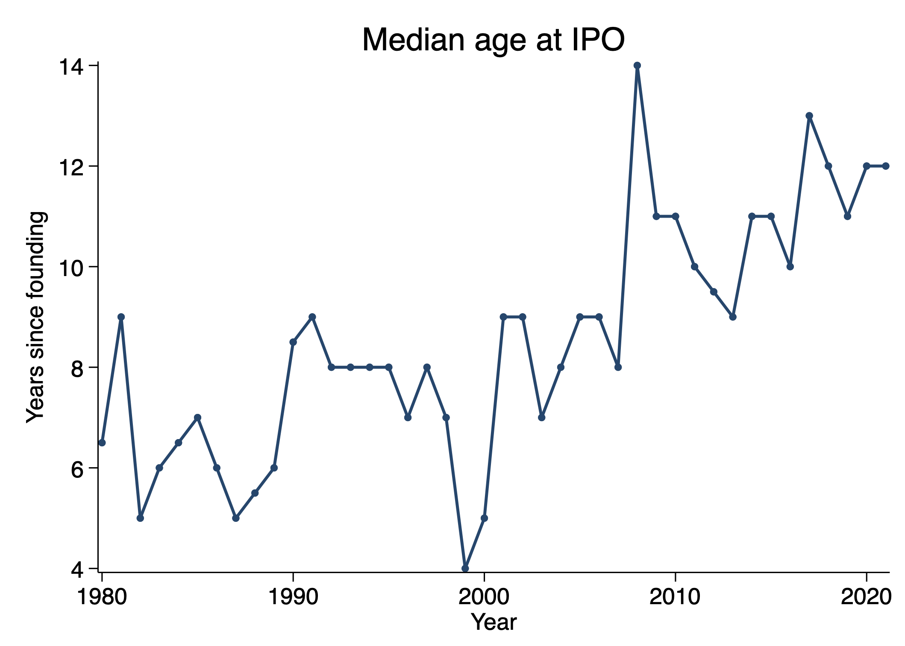
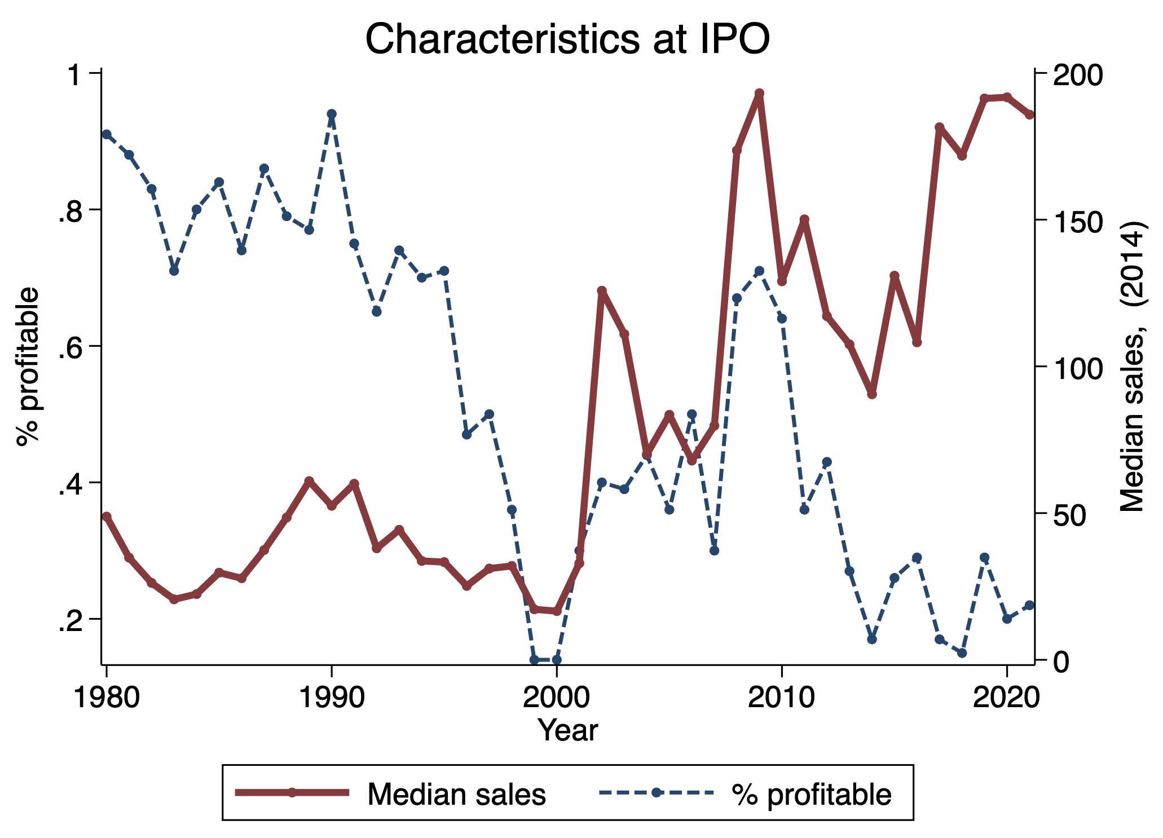
Older, bigger, and less profitable at IPO
Ritter (2022)

Slide 17
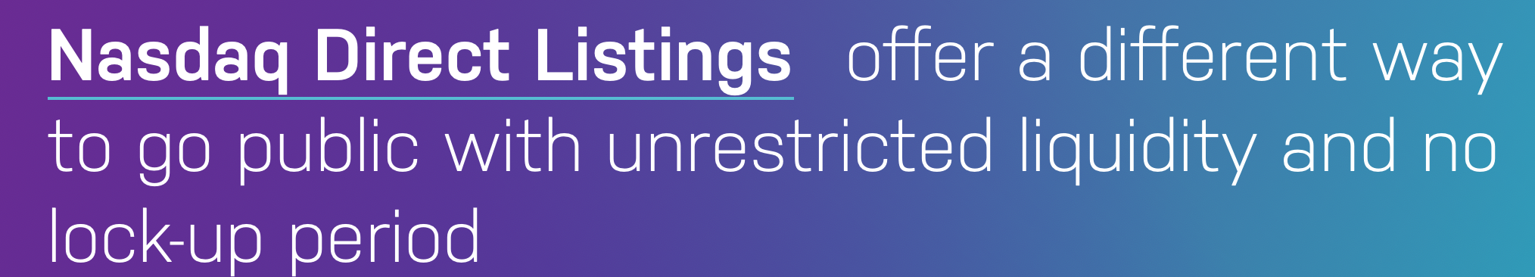
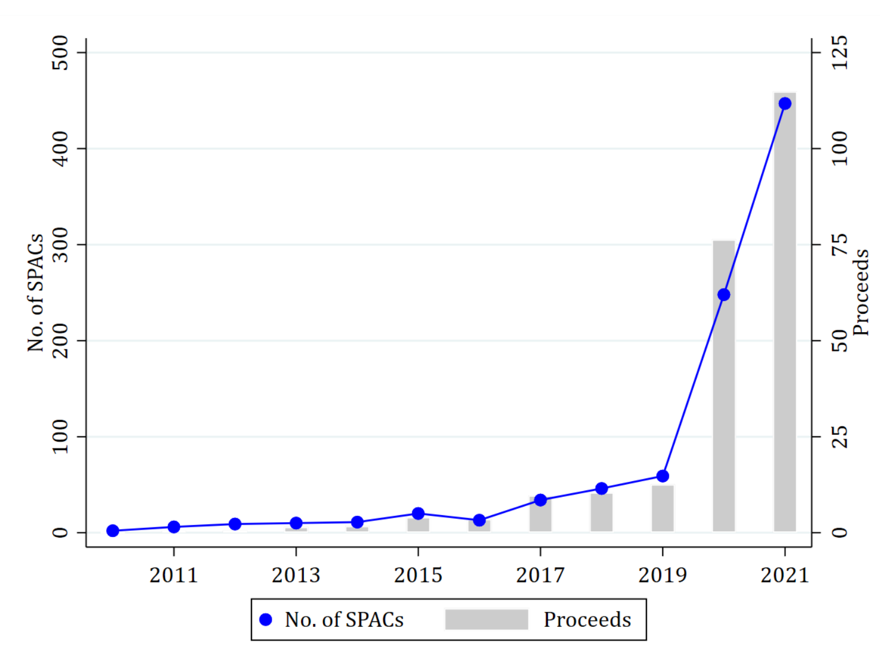
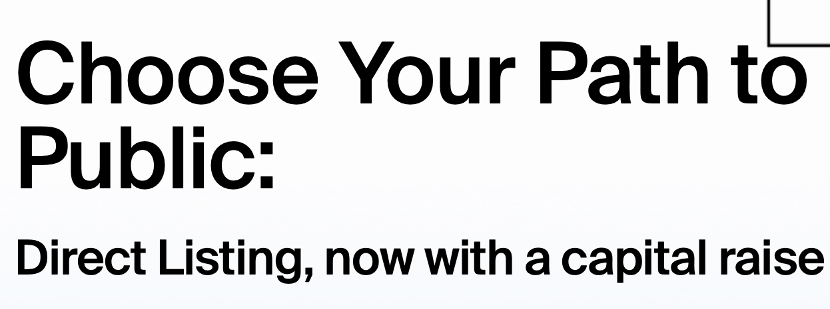
Innovation in listing options
Increase in SPAC activity (Gahng, Ritter and Zhang, 2022)

Slide 18
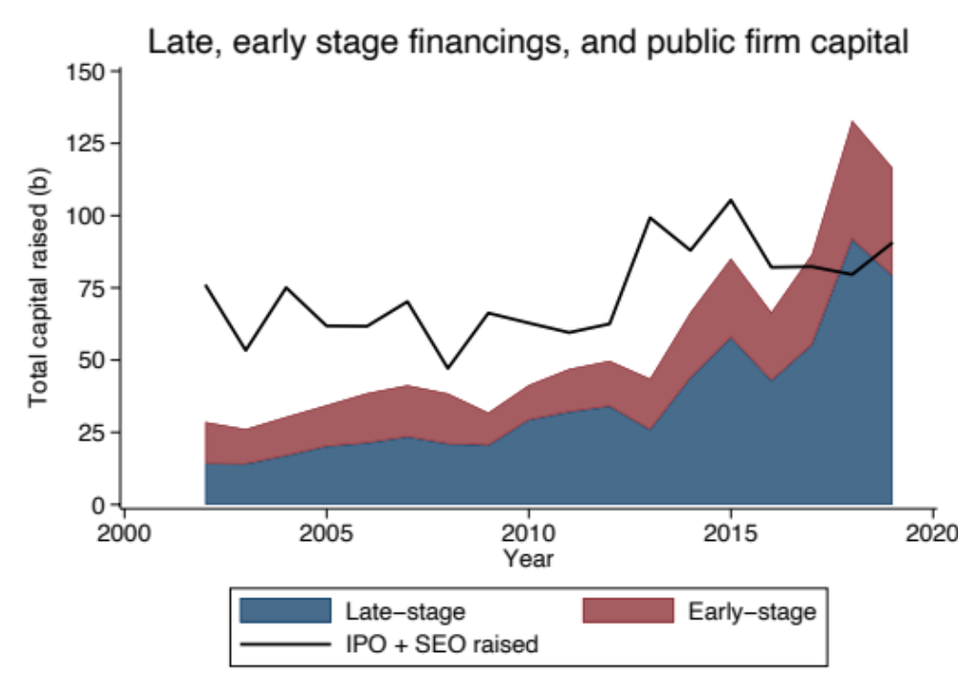
Public equity capital raising vs. VC
Since 2017, capital raised by VC-backed startups > IPO and SEO offerings

Slide 19
Private capital market changes
More startups and a lot more capital

Slide 20
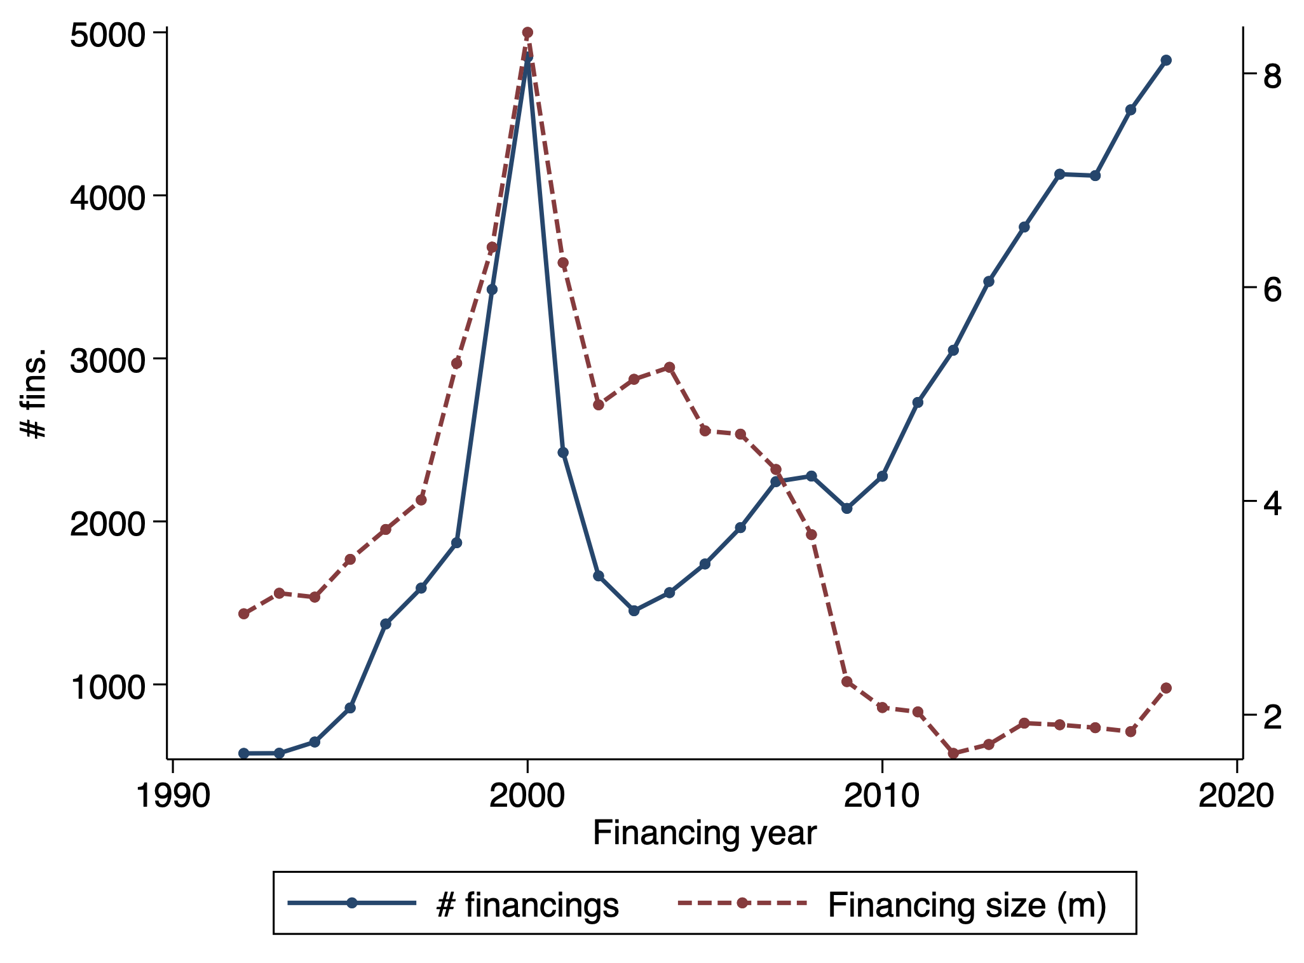
More early-stage startups raising smaller rounds
# financings
Early-stage startup financings back to dot-com peak
Median round size fallen 2.5X since 1997
Median capital
raised $m
Source: VentureSource, author calculations

Slide 21

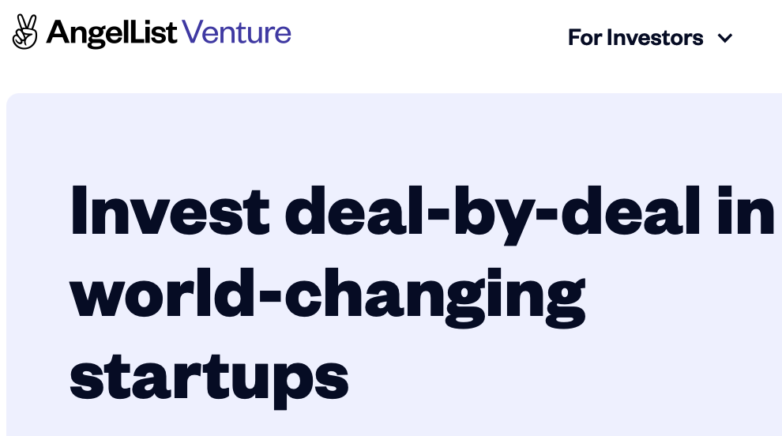

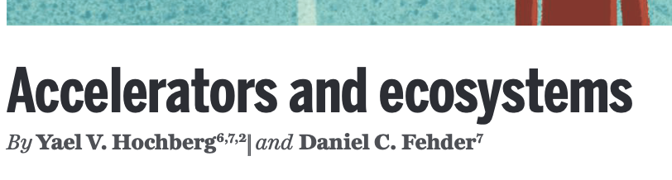
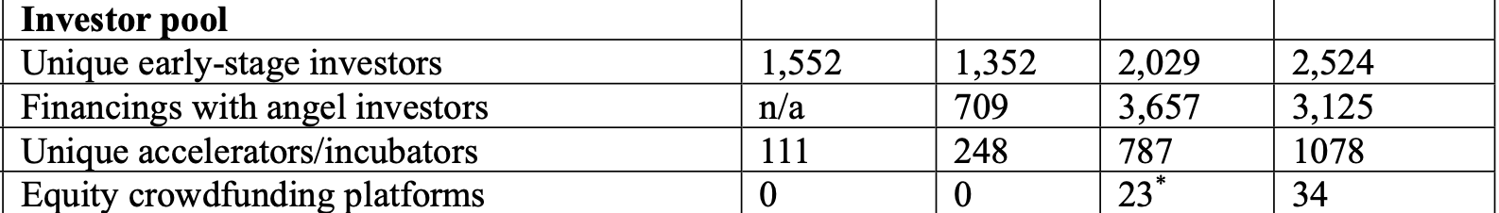
New early-stage investors and changing VC
Since early 2000s, emergence of new early-stage and retail investors using non-traditional financing model

Slide 22
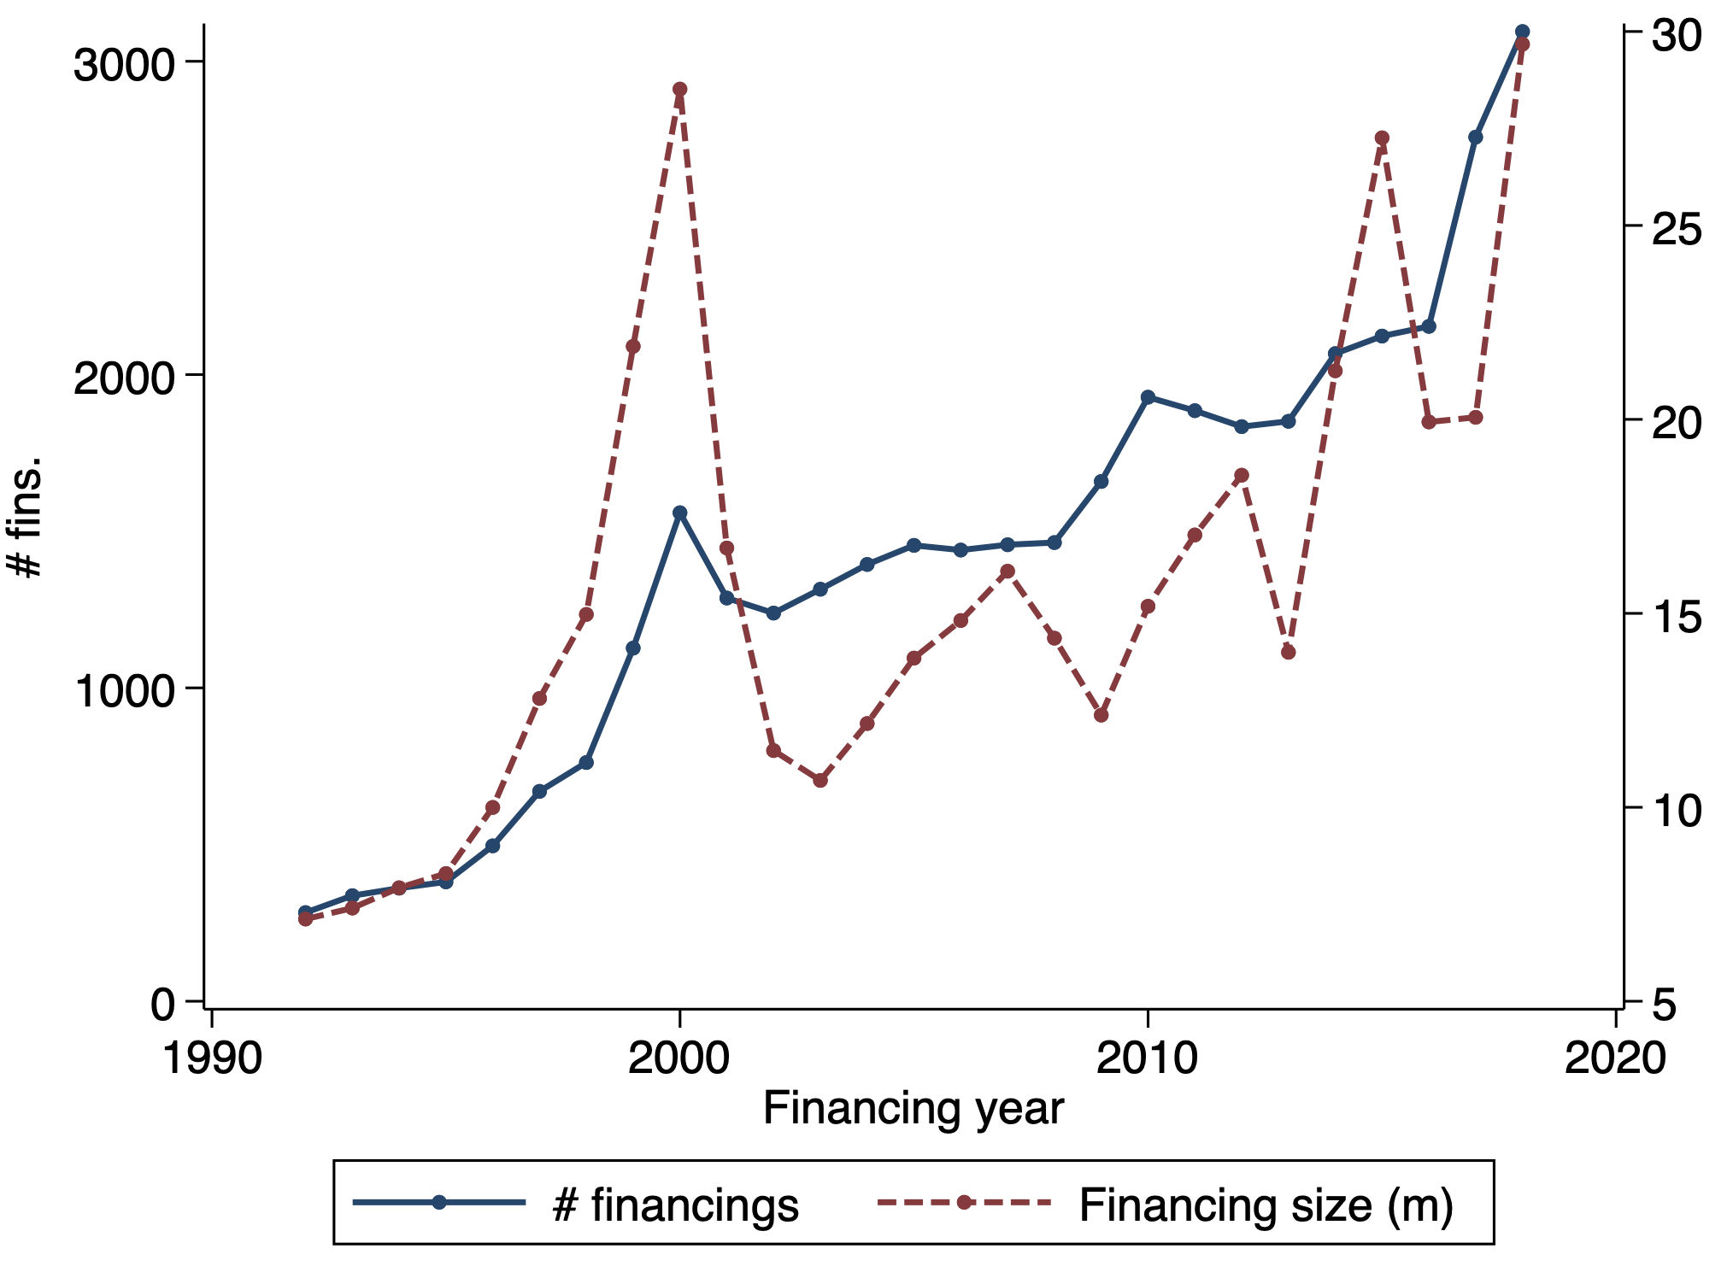
Late-stage financing growth
# financings
90th percentile IPO size pre-1997: $99m
2002, 6 financings > $99m
2019: 189 financings > $99m
Avg. capital
invested $m
Source: VentureSource, author calculations

Slide 23
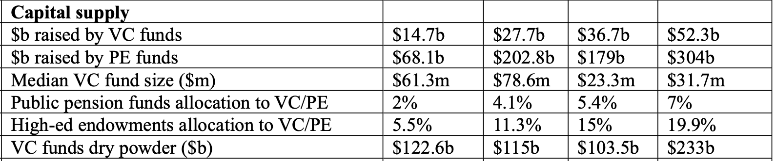
Changes in the capital supply since 2002
Roughly 3X increase from 2002 – 2019
VC funds raised
VC/PE allocations by public pensions
VC/PE allocations for higher-ed endowments

Slide 24
What drives these changes?
Regulation
Changes affecting investors (supply side)
Changes affecting startups and founders (demand side)

Slide 25
Regulation (and deregulation)
NSMIA (1996)
Pension Protection Act (2006)
  Easier for VC/PE funds to raise capital from governmental pension plans w/o triggering costly fiduciary rules
JOBS Act (2012) and regulatory follow-ups
  AngelList no-action letter
  Reg Crowdfunding (provides regulatory framework)
  Easing of no-solicitation rules (Rule 506(c))

Slide 26
NSMIA (National Securities Market Improvement Act of 1996)
Federal preemption of state blue-sky laws for private capital raising
  → easier to raise private capital across state lines, most helpful for late-stage startups
↑ cap on # of investors that trigger fund registration
→ VC/PE funds can raise $ from more investors w/o registering, most helpful for late-stage funds aiming to raise large funds

Slide 27
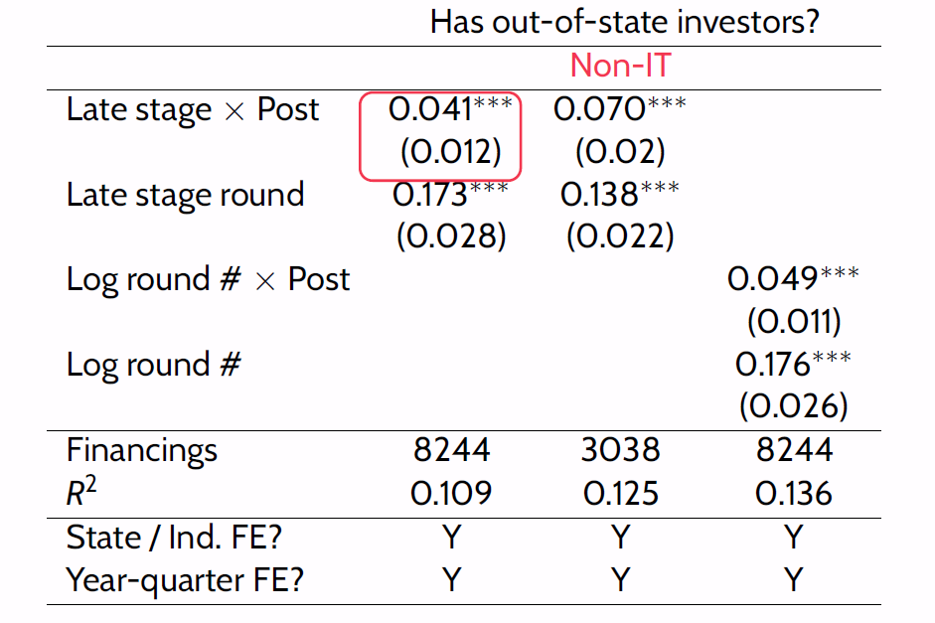
Late-stage startups (“treated” by NSMIA) increase reliance on out-of-state investors after NSMIA relative to early-stage startups
Increase driven by startups in states w/ non-standardized blue-sky laws (triple-diff)
Ewens and Farre-Mensa (2020)
After NSMIA, similar diff-in-diffs show …
  late-stage startups able to raise larger amounts of capital
  late-stage focused funds able to raise larger funds
  Late-stage startups == IPO candidates

Slide 28
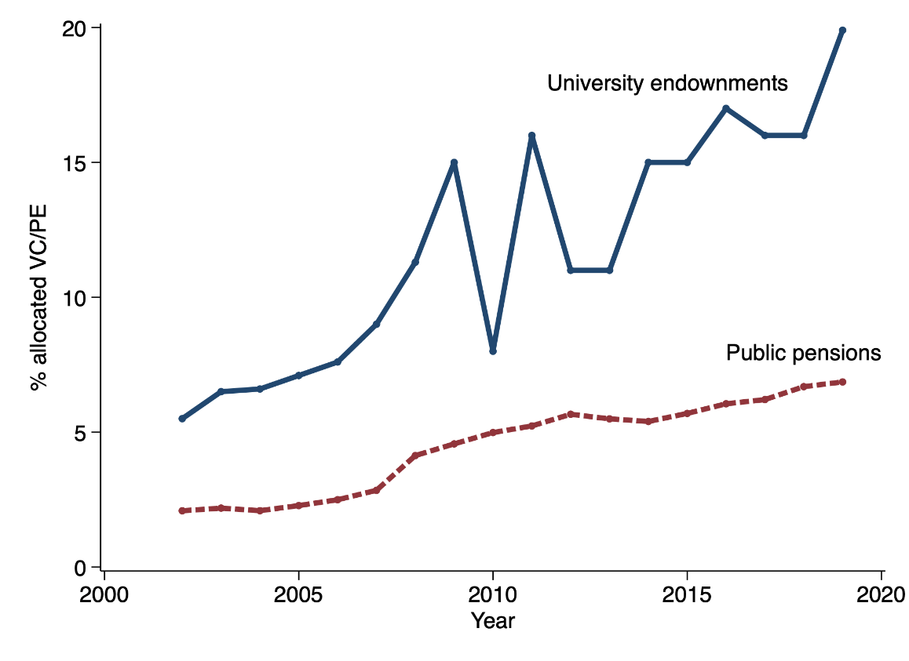
Changes affecting investors (non-regulatory)
  More capital allocated to VC/PE funds by some of their major LPs, s.a. higher-ed endowments and public pension funds

Slide 29
Changes affecting investors
  More capital allocated to VC/PE funds by some of their major LPs, s.a. higher-ed endowments and public pension funds
  Why?
  Higher-ed: chasing the Yale endowment returns? (Lerner et al. 2008)
  Public pension funds: Pension gap from $0 in 2001 to $1.25 trillion in 2019
    Higher expected returns → lower gap
    Public pension funds assign highest expected return VC/PE, mean expected net return of 12% (Andonov & Rauh 2021)
      Compare to 1.5% Treasury rate in 2020, down from 5.2% in 2001

Slide 30
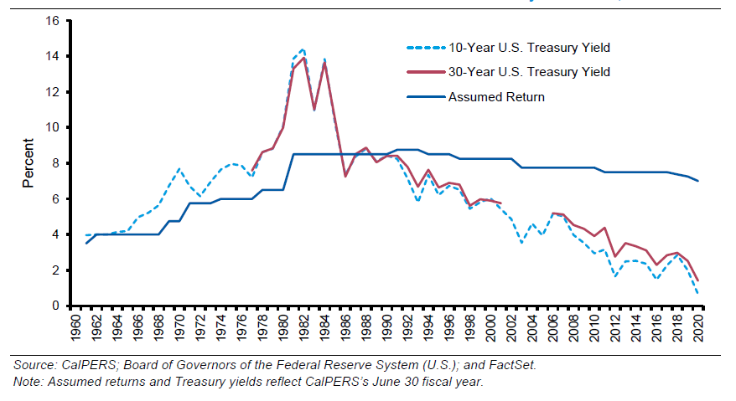
Changes affecting investors
  More capital allocated to VC/PE funds by some of their major LPs, s.a. higher-ed endowments and public pension funds
Mauboussin and Callahan (2020)

Slide 31
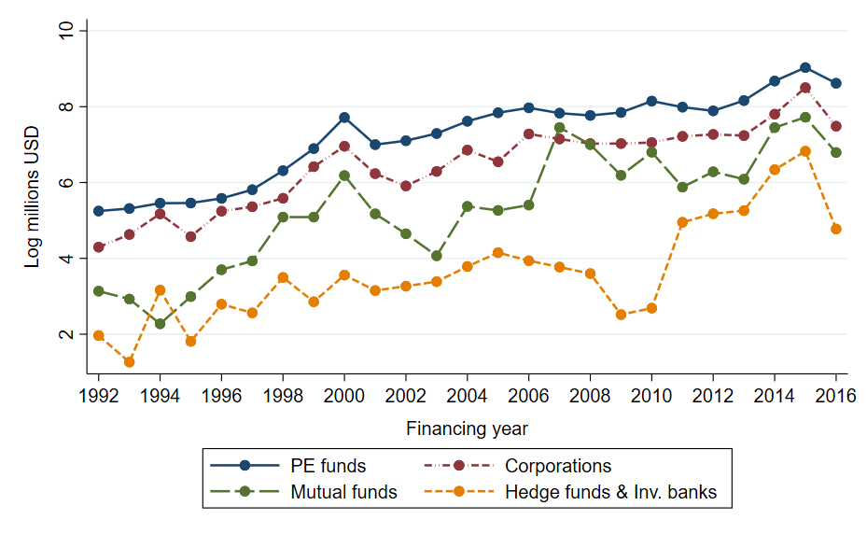
Changes affecting investors
  Increased willingness of traditional public investors to invest in private mkts (Aragon et al. 2018, Kwon et al. 2020, Agarwal et al. 2021, Chernenko et al. 2021, Huang et al. 2021)

Slide 32
Changes affecting investors
  Increased willingness of traditional public investors to invest in private mkts
  Why?
  Traditional IPO firms are now in private markets (circular argument…)
  Investing in private firms can help mutual/hedge funds beat passively managed index funds and ETFs—and so justify their higher fees

Slide 33
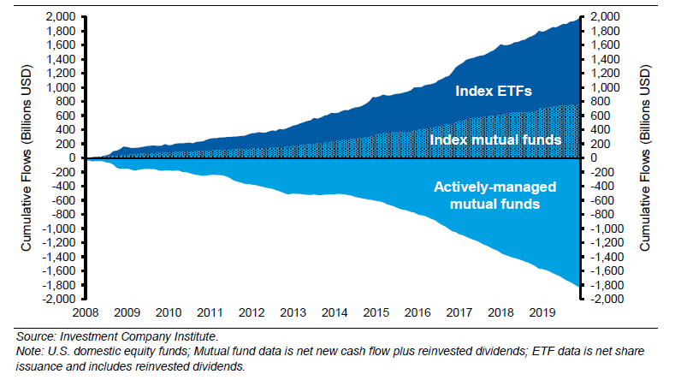
Changes affecting investors
  Increased willingness of traditional public investors to invest in private mkts
Investing in private firms can help mutual/hedge funds beat passively managed index funds and ETFs—and so justify their higher fees
Mauboussin and Callahan (2020)

Slide 34
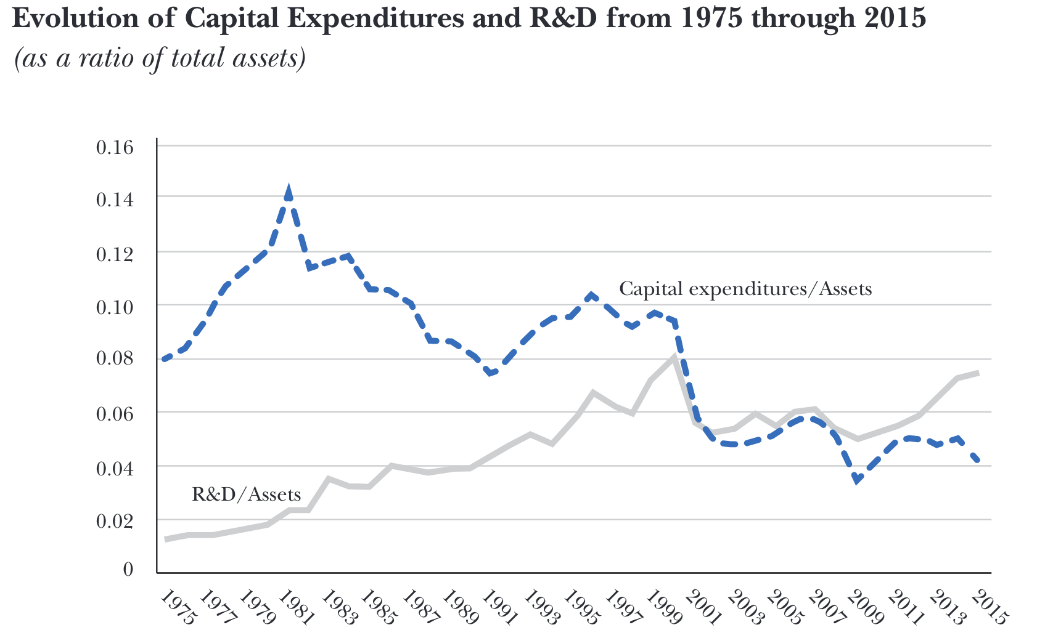
Changes affecting startups and founders
Kahle and Stulz (2017):
“Raising equity in public markets to fund R&D can be difficult. Investors want to know what they invest in, but the more a firm discloses, the more it becomes at risk of providing ammunition to its competitors. As a result, R&D-intensive firms may be better off raising equity privately from investors who then have large stakes.”
Kahle and Stulz (2017)

Slide 35

Changes affecting startups and founders
Technological innovations have decreased startups’ capital needs, particularly during the initial, experimental stage of the entrepreneurial process—when capital is most expensive
  Cloud computing’s emergence in 2006 (AWS)
  build software products w/o significant upfront investments
  → raise less capital (Ewens et al. 2018)
  Also, biotech (e.g., CRISPR)

Slide 36
Changes affecting startups and founders
Technological innovations have decreased startups’ capital needs, particularly during the initial, experimental stage of the entrepreneurial process—when capital is most expensive
  Cloud computing’s emergence in 2006 (AWS) → build software products w/o significant upfront investments → raise less capital (Ewens et al. 2018)
  Mark Andreessen:
    “In the 90s, if you wanted to build an Internet company, you needed to buy Sun servers, Cisco networking gear, Oracle databases, and EMC storage systems... and those companies would charge you a ton of money even just to get up and running. The new startups today, they don’t buy any of that stuff... ”
  Mark Suster:
    “Amazon in turn led to the formation of an earlier stage of venture capital now led by “micro VCs” who typically invest $250-500k in companies rather than the $5-7 million that VCs used to invest.”

Slide 37
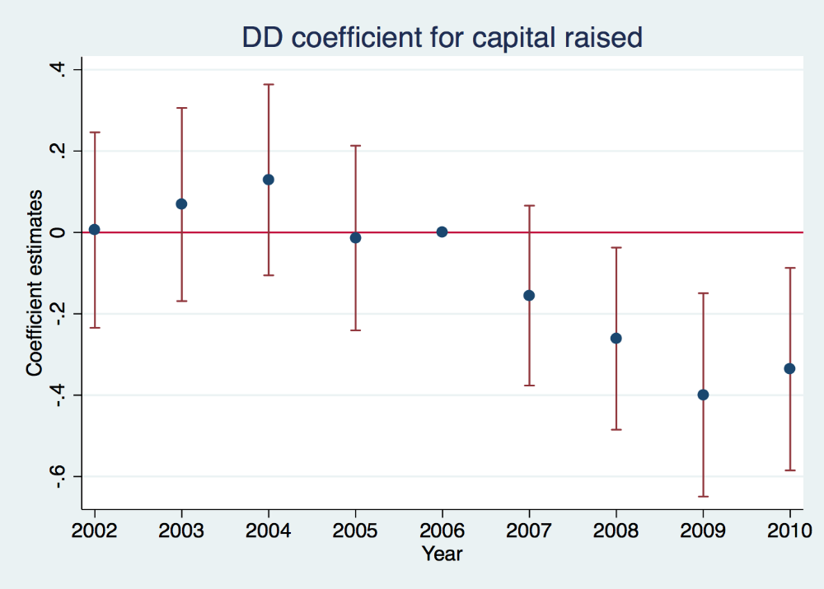
Changes affecting startups and founders
Introduction of the “cloud” as a shock to the cost of experimentation
15-29% reduction in capital raised in first round financings
  Ewens, Nanda, and Rhodes-Kropf (2018)

Slide 38
Connecting the dots
Regulatory changes and investor-level changes have increased the supply of private capital
Technological changes have decreased startups’ demand for capital, particularly in early stages, when capital is relatively most expensive
When startups reach age at which they could go public, founders retain more control of their firms → more influence on exit decisions
  Founders often prefer staying private (less scrutiny, more control; Brau & Fawcett 2006)

Slide 39
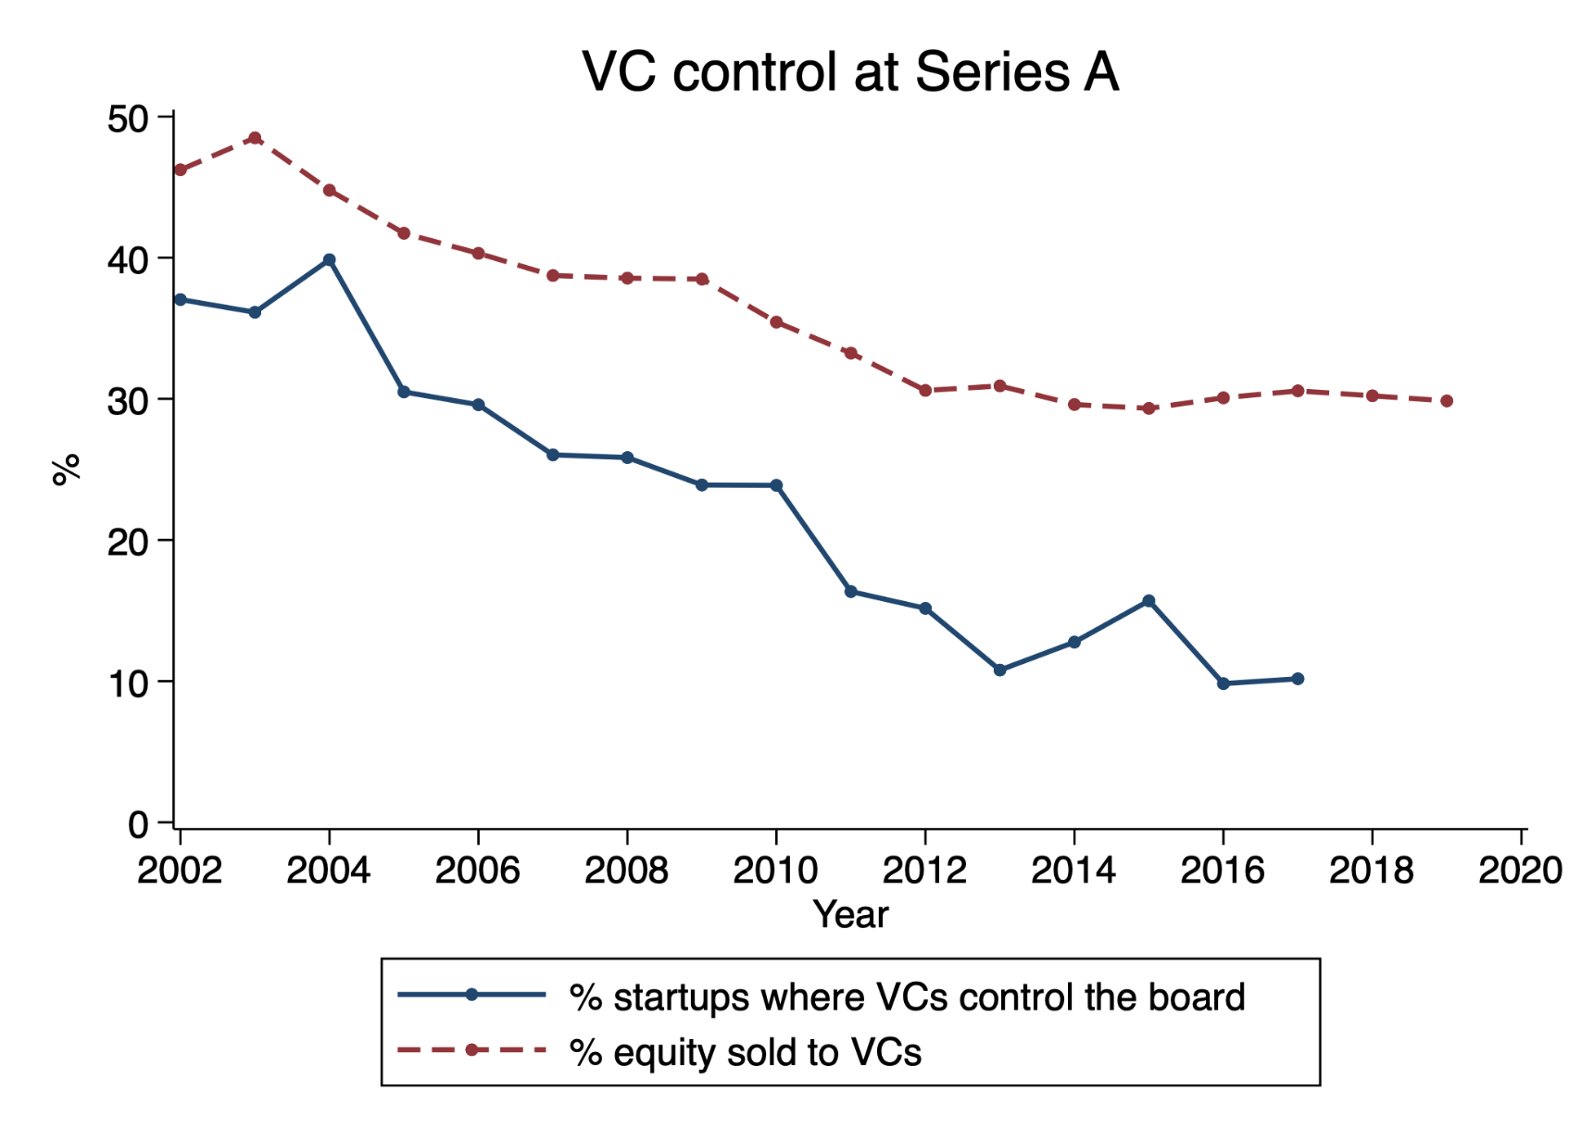
Founders have more bargaining power to make exit decisions, which allows them to delay exits

Slide 40
More founder equity → less likely to exit
Do increases in founder equity lower probability of exit? (yes)
Ewens & Farre-Mensa (2020): exploit variation in founder equity stemming from exogenous shifts in VC supply when startup founded
  IV: State pension fund assets × % state official in board of trustees (“home bias”)
  More abundant VC supply → Founders get to keep more equity
Instrumented increases in founder equity decrease prob. that a startup exits (IPO or M&A) w/in 7 yrs of first VC

Slide 41
Do these changes work for everybody?
Problem for founders and employees: lack of liquidity (“paper millionaires”)
  Growth in secondaries might help alleviate
Problem for early investors: exits are delayed, possibly beyond the end of their funds’ lifecycle
  Can secondaries solve this? (e.g., Series A VC sells to Series E VC/PE)
    Unclear: Adverse selection concerns stronger than w/ founders/employees
  Evergreen funds, changes to funds lifecycles?

Slide 42
Regulators’ response to this new environment
Spillovers in capital market regulations

Slide 43
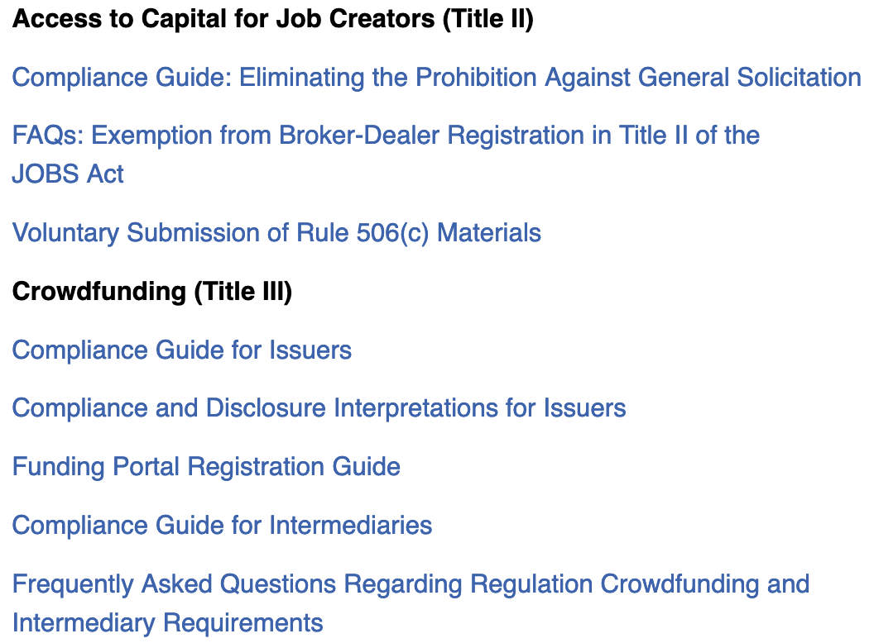
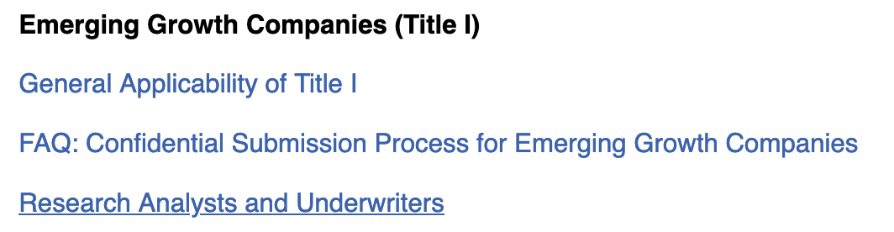
Regulatory tug-of-war: JOBS Act as a case study
Public market deregulation
Private capital market deregulation
Easier to go and be public as a “small” firm
Lower private capital raising frictions

Slide 44
Expand retail investors access to VC/PE
SEC’s Asset Management Advisory Committee “Final Report and Recommendations for Private Investments”:
Asset management growth in self-directed retirement
Decline in the # of investment opportunities (i.e., “where are the small caps”?)
→ allow retirement accounts or individuals to invest in PE
VC/PE could possibly provide (Brown et al., 2020)
  higher expected returns
  diversification benefits

Slide 45


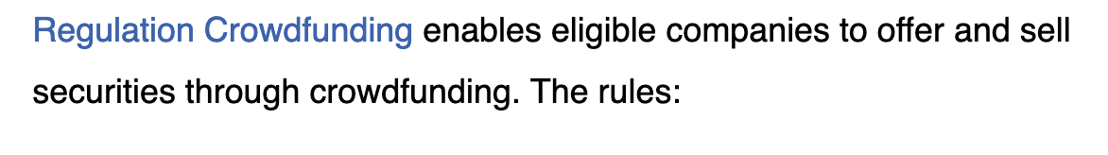
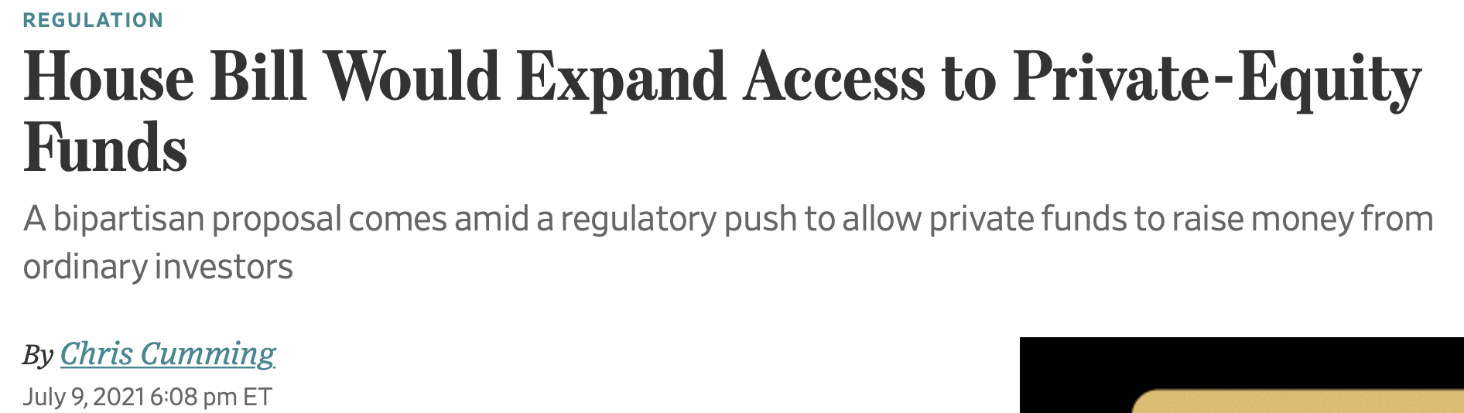
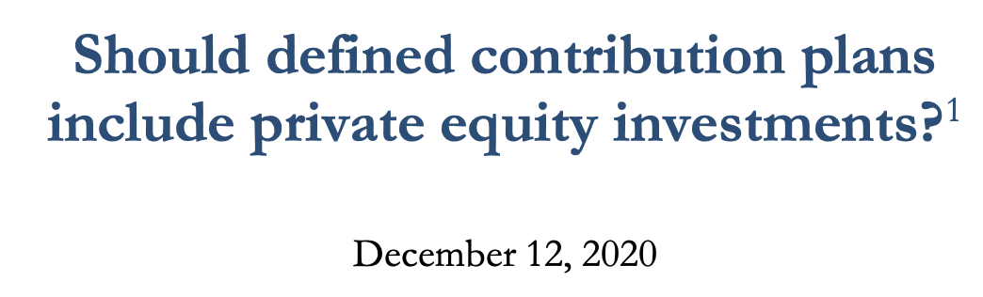
Expand investors’ access to VC/PE
“[W]e view the supply side for retail investors as being less diversified than 15 years ago.”
- Asset Management Advisory Committee
Final Report and Recommendations for Private Investments
Brown et. al. (2020)

Slide 46
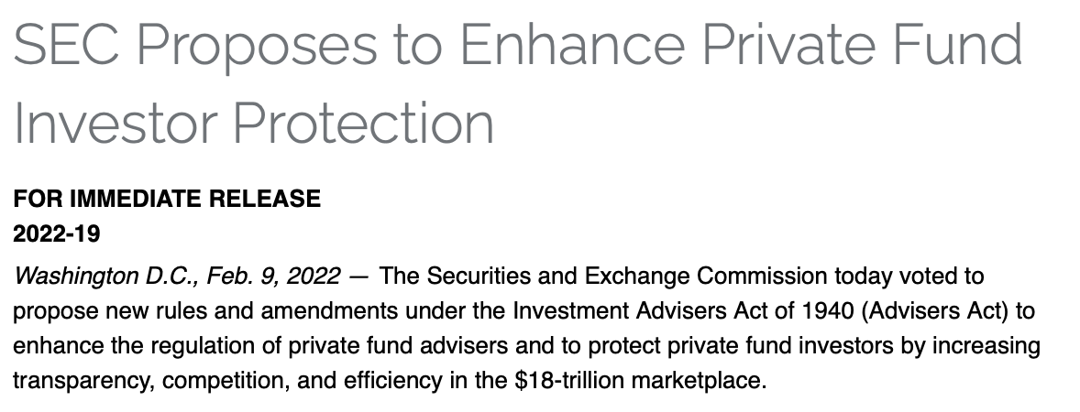
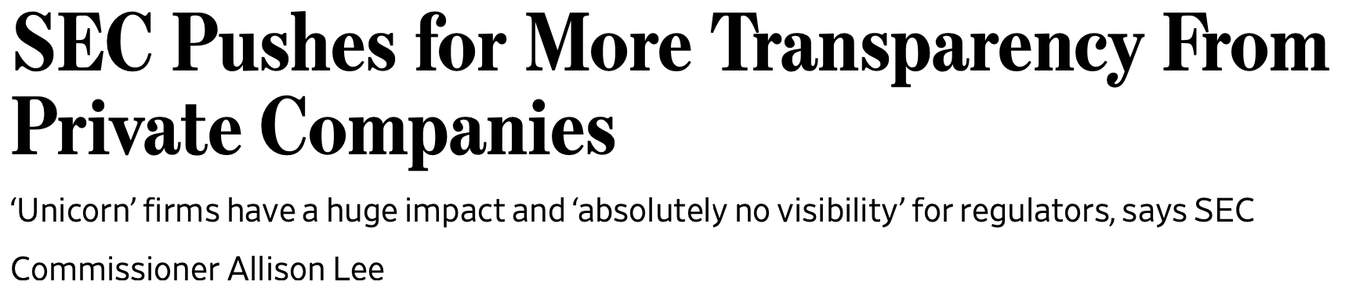
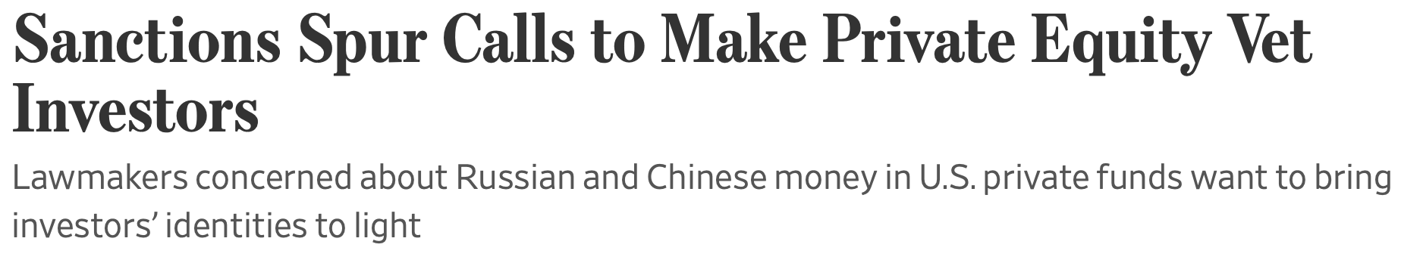
Regulatory challenges of increased investor access
To protect retail investors in private mkts, may need to regulate private firms more like public ones:
  E.g., shrink disclosure gap btw/ public and private firms
Private firms may lose some of their key advantages

Slide 47
Open research and policy questions
Connection btw startup higher valuations and + founder-friendly contracts, and returns earned by VC/PE asset class (Harris et al. 2020)?
How do the changes in the late-stage financing market impact the traditional VC investing model?
Real consequences of decline in listed firms: e.g., less information on prices and investment opportunities → less efficient investment?
How can other countries foster a thriving entrepreneurial finance market, particularly for late-stage startups?
  “[EU]later-stage financing in particular remains restricted” (EC 2018)

Slide 48
Thank you!
Follow paper updates here: https://privatepublicmkts.com/
mewens@caltech.edu

